Slide 1


Supporting children to stay focused on home learning
Some children find it very hard to remain focused for extended periods of time. Below are some strategies to help children with this.

Slide 2
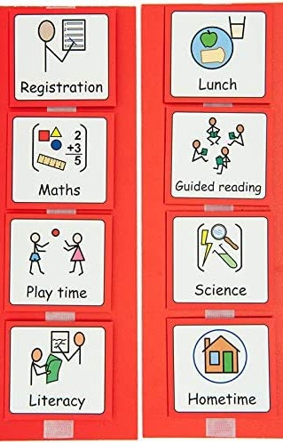
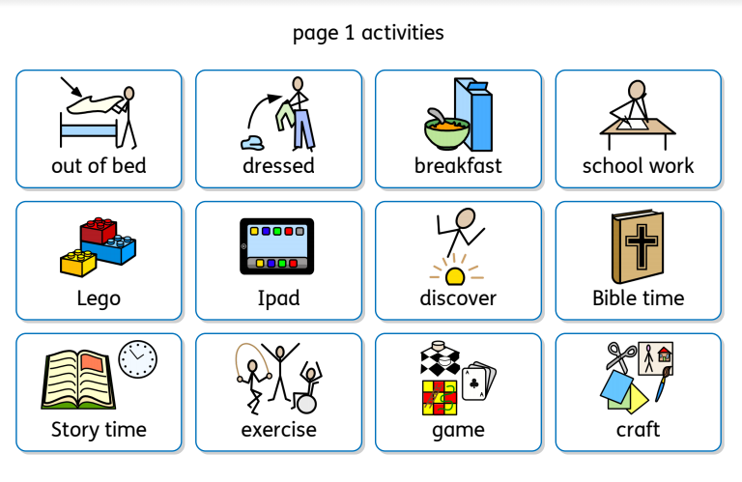
Clear Daily Timetables
Having a clear timetable for the day really helps children to know what is expected of them and also to prepare themselves for what is coming next.
Visual timetables really help and many children find it really useful to remove the picture once that session is completed. This allows them to see the day in sections and therefore make it much more manageable.

Slide 3
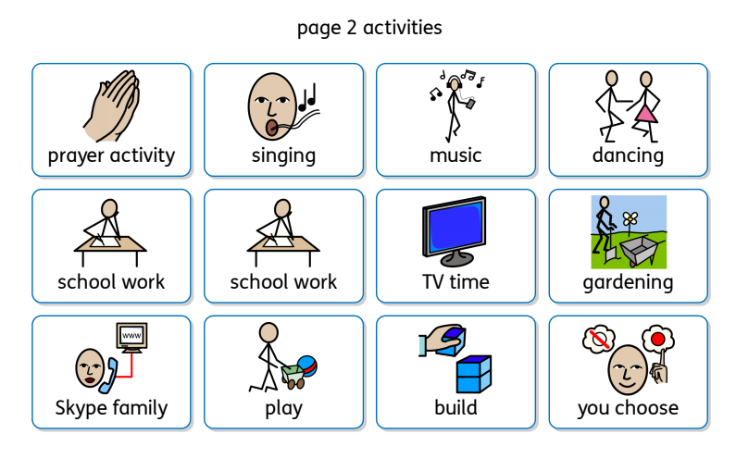
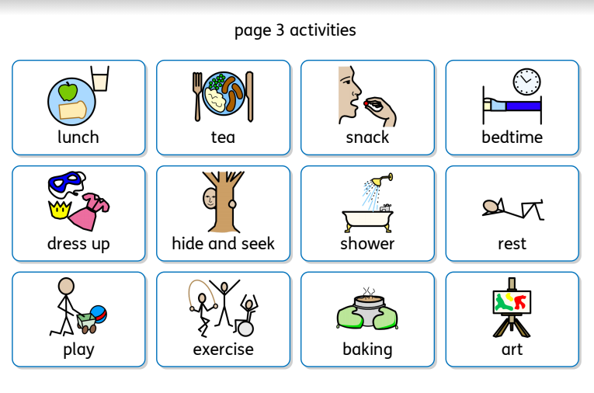
You could enlarge and print these visual timetable cards to show your daily activities.

Slide 4
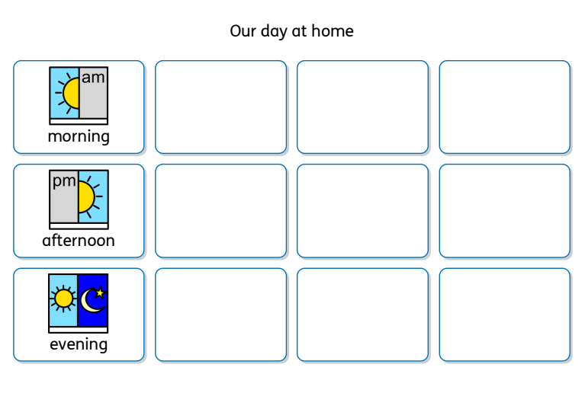

Slide 5

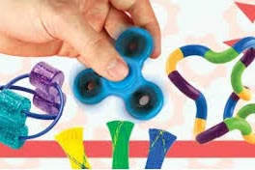
Reduce Distractions
Learning at home can be challenging for some children, particularly those who see school as the place for learning and home is not.
Select seating wisely
You know your child best and know what will distract them at home. Generally advice is to try to avoid seating near doors or windows as this can provide potential distractions.
Allow distraction blockers
Fidget toys are often used to provide sensory input in a less distracting way. They can help improve concentration and attention to tasks by allowing the brain to filter out the extra sensory information e.g. listening to a lesson.

Slide 6
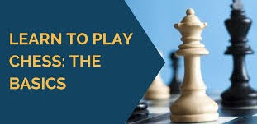
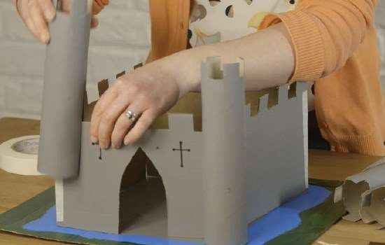
Go with your child
How much or how little you expect your child to do each day will very much depend on how your child is feeling. It is really good to encourage your child to share how they are feeling at the start of each session so you can judge what you are going to ask them to do and how many learning breaks etc might be needed.
Making the learning personal to your child really helps to enhance engagement levels. The lesson of the day might be writing instructions about how to make a model castle, but your child may not be interested in castles. Always try, where possible to make the learning important to them. If your child likes Pokemon or chess for example, why not ask them to write the instructions of how to play either of these. Explain these can be shared with others who do not know how to play which gives the learning real purpose for them

Slide 7
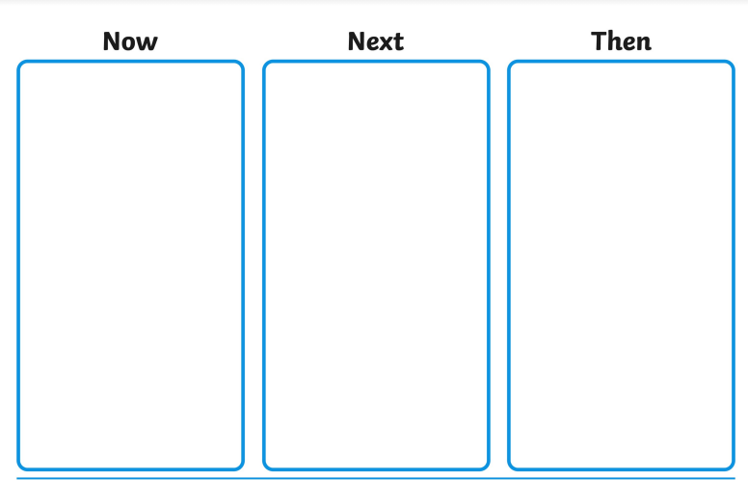
Now and Next
When children are faced with a piece of work, sometimes it can feel like they have a mountain to climb. Breaking it down into much smaller sections can really help children focus on one task at a time, without feeling overwhelmed. Equally, using a 'Now and Next' model can also help to hold children's attention and keep them interested.
Break work down into smaller sections

Slide 8

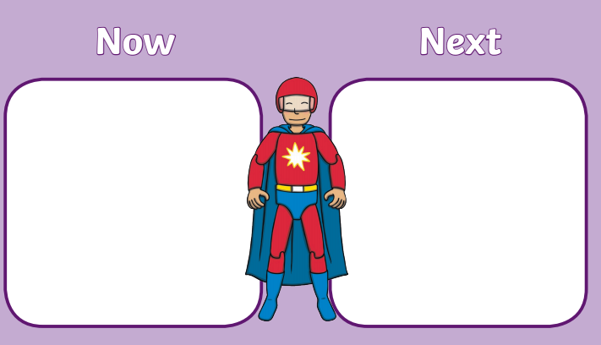
When using a now and next board, the now tends to be a learning / demanding activity and the next is usually a reward/motivator. For example, if your child was working in year 2 and they were writing a letter it might look a little like this:
Now: Write the introduction of the letter
Next: 5 mins lego building
Now: Write the middle of the letter
Next: 5 mins lego building... and so on.
The key to success with these boards is to ensure that children have a clear understanding of the time. Use of sand timers or even Alexa (if you have one) can be very useful.

Slide 9
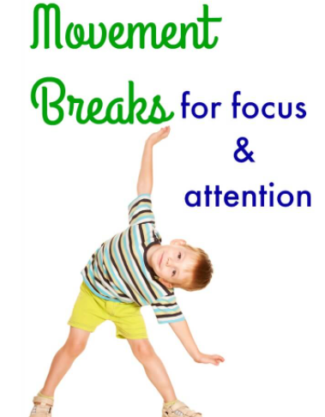
Learning Breaks
Learning Breaks for children are when children are given a short mental break from the focused task taken at regular intervals. Most learning breaks range from around 5 to 20 minutes as a general rule, although most people prefer to keep them short. For maximum success, it’s usually best to include a physical activity.
The benefits of using learning breaks include helping children to:
be calmer
remain focused
less prone to daydreaming
in a better mental place to face the next challenge
As we all know, children have lots of expendable energy and it can often present itself at inopportune times.

Slide 10
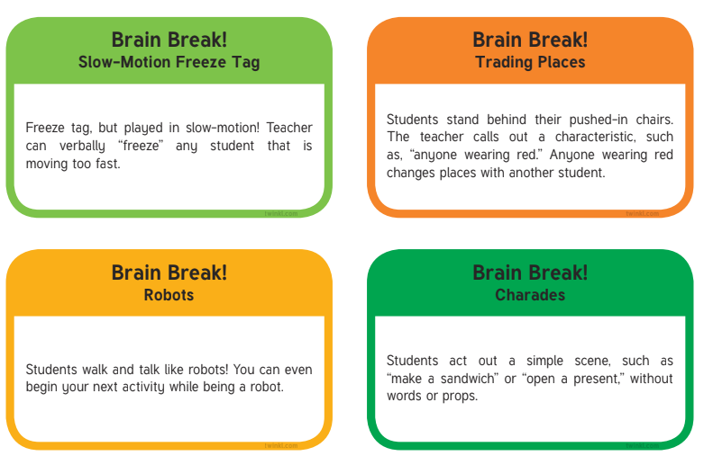
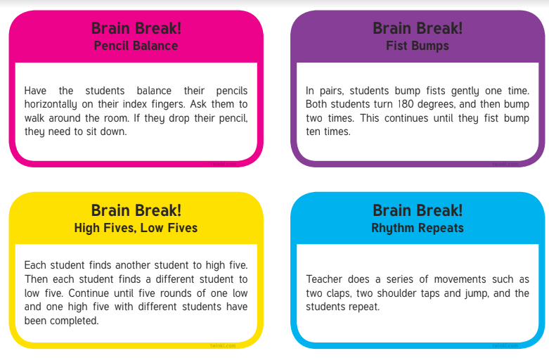
Learning breaks have also shown to significantly reduce stress and anxiety levels too, providing organic improvements to learning and higher engagement levels.

Slide 11
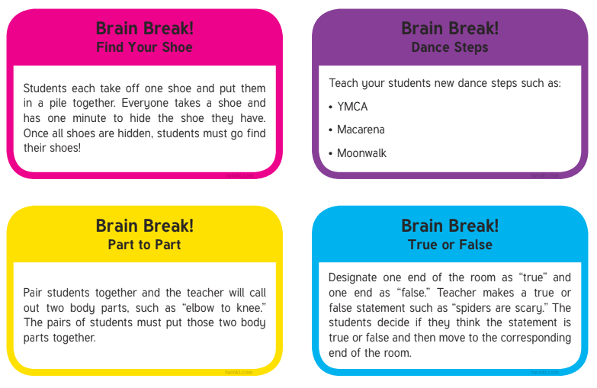
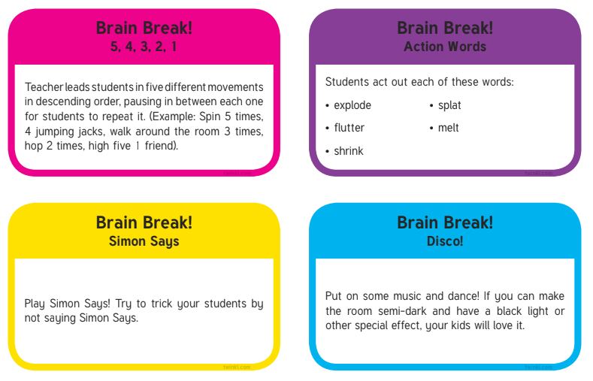
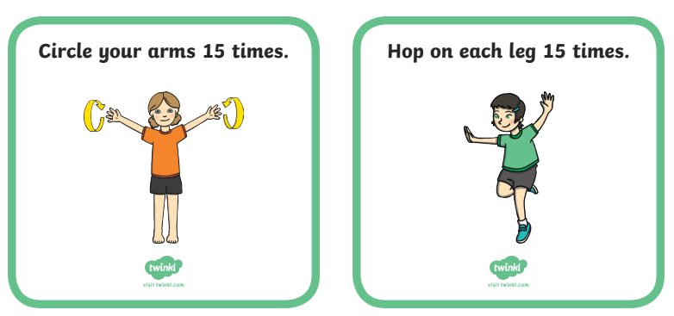
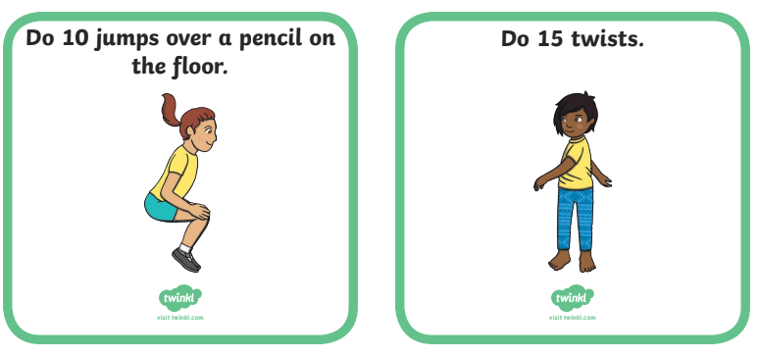

Slide 12

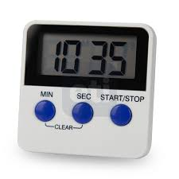

Set a timer
Knowing there’s a limit to how long they have to stay focused can make it easier for kids to hang in there. Set a timer for how long your child needs to work before having a quick snack or taking a play break. You can increase the amount of time little by little as your child gets better at focusing.

Slide 13
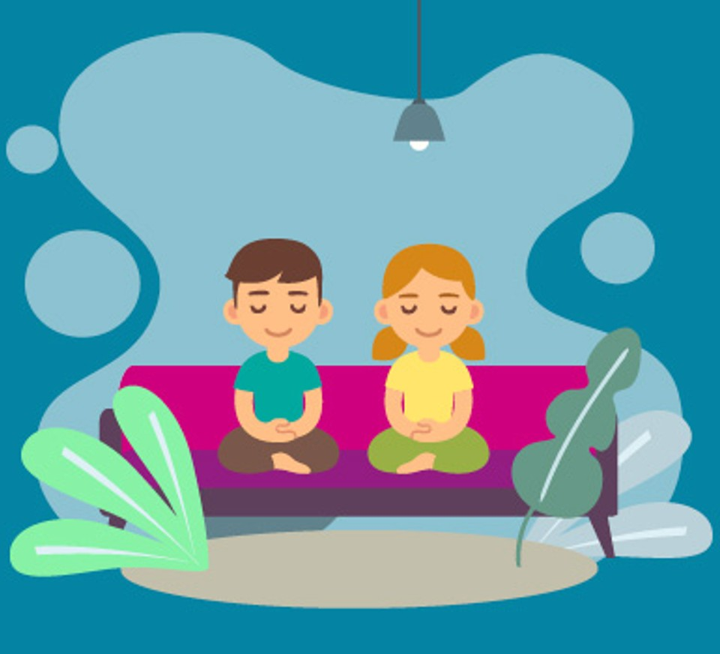

Try mindfulness
Mindfulness exercises are all about paying attention and focusing. Studies have shown that mindfulness can help kids improve their behavior and their ability to focus on lessons and on schoolwork.
One way to practice is to sit quietly and focus on breathing in and out. Taking even a few deep breaths before class or a test could make a difference.

Slide 14
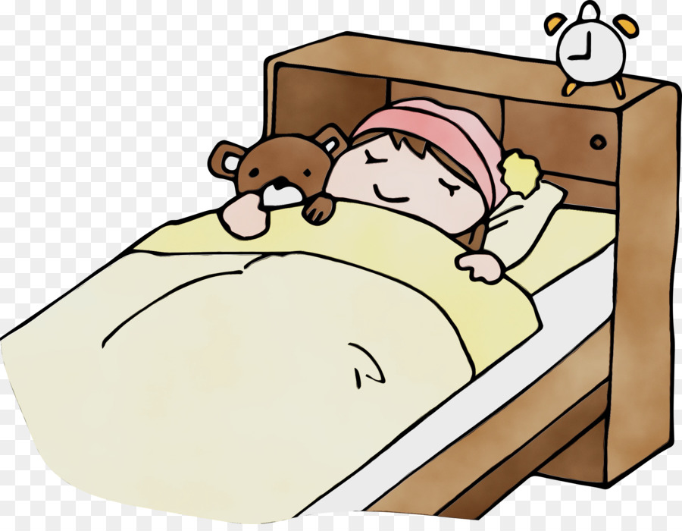

Stick to a set bedtime and wake up routine
A well rested mind is a focused mind. Help your child create and stick to a nightly routine so he or she gets to bed at a decent hour. A good sleep will help give your child’s mind a chance to absorb everything from the day and recharge for tomorrow

Slide 15


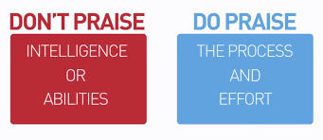
Struggling with focus or any other skill can take a toll on a child’s self-esteem. Praise your child’s hard work to improve focus. Point out even small improvements. And let your child know that focus skills can get better.
And remember to talk about your child’s strengths, not just challenges. Celebrate focus wins, big and small. When kids understand what they’re good at, it builds confidence and helps them stay motivated when things get tough.

Slide 16
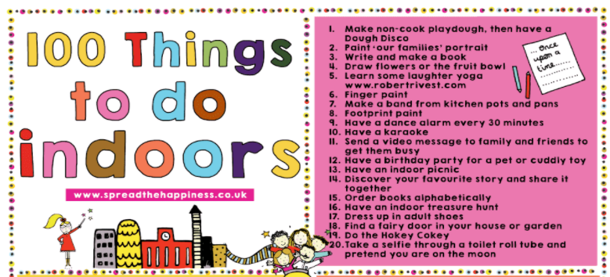
Alternative ideas for learning at home
If the online learning is not working out on a particular day, there are a wealth of ideas to try instead.

Slide 17
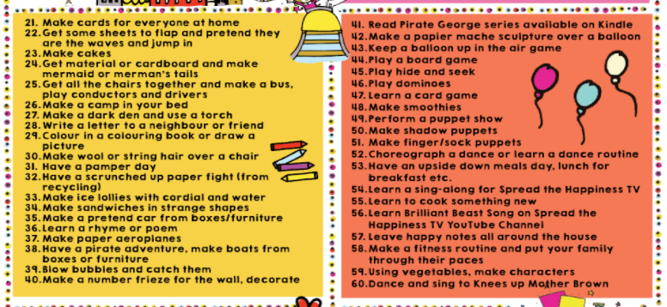

Slide 18


