Slide 1
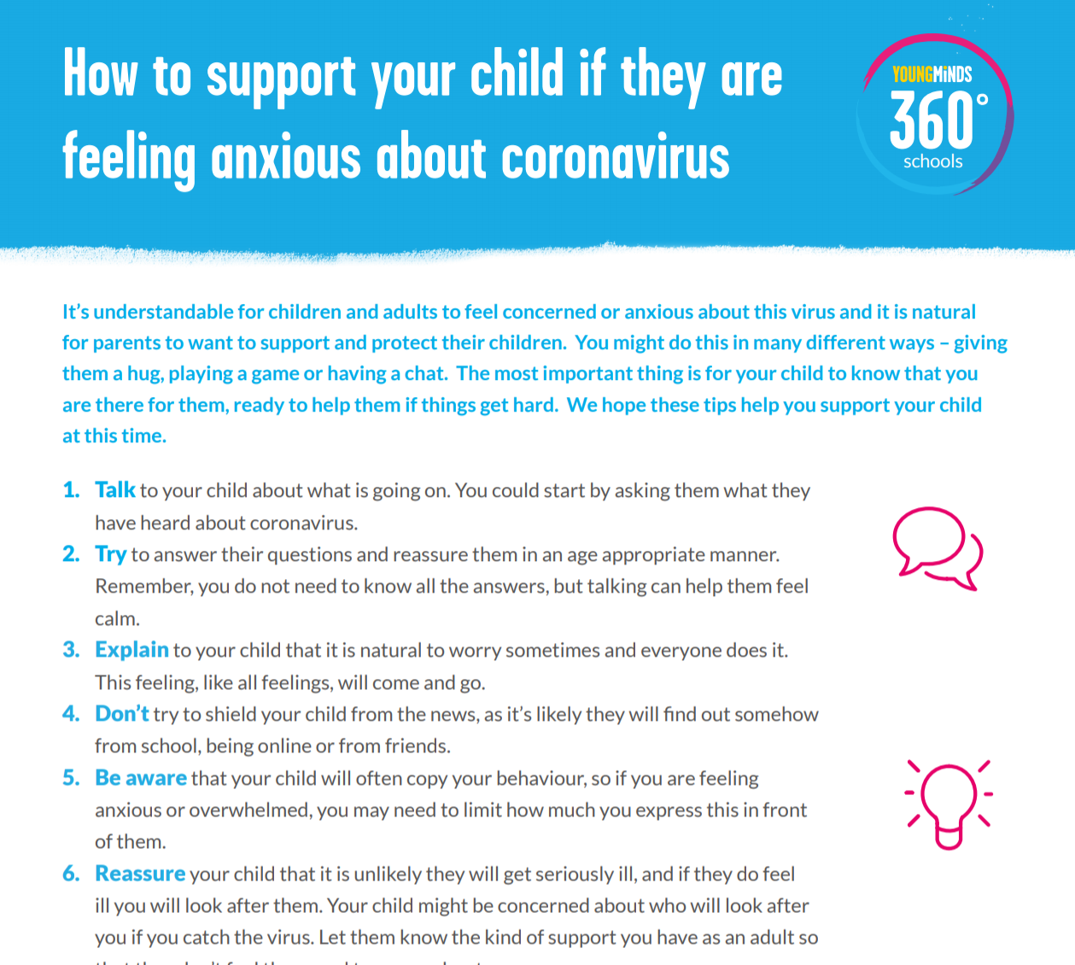
Helping children make sense of Coronavirus
Supporting children to understand Coronavirus
Your child may understandably be concerned or worried by what they see, read or hear in the news or online regarding coronavirus (covid-19). As a parent or carer, it’s good to talk to them honestly but calmly about what is happening, and to not ignore or shield them from what is going on in the world. Children look to adults in their life for comfort when they are distressed, and will take a lead on how to view things from you. Remember, you don’t have to have all the answers, but it is better to have a gentle conversation to reassure your child that they can talk to you so they don’t feel like they’re on their own. (Young Minds 2020)
Click HERE to access a information for Parents/Carers: Supporting your child during the coronavirus pandemic.

Slide 2
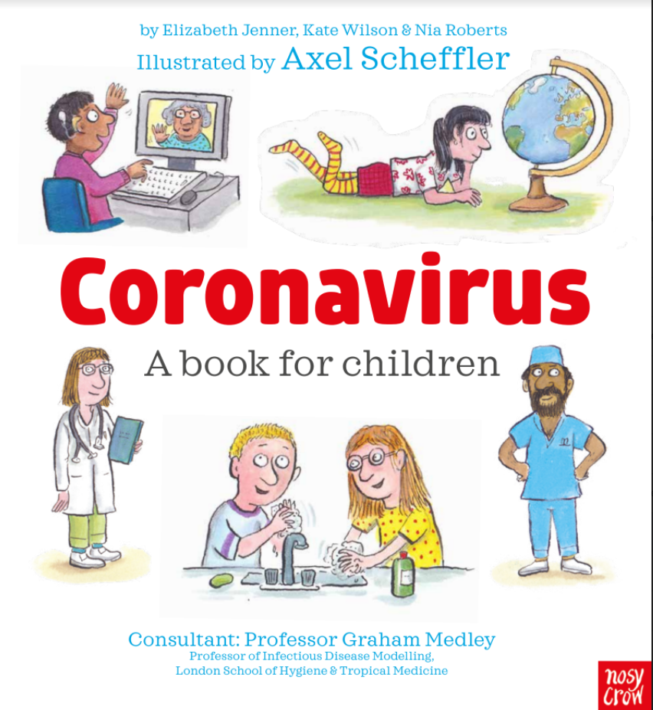
Click HERE to access a story to share with your child about Coronavirus

Slide 3
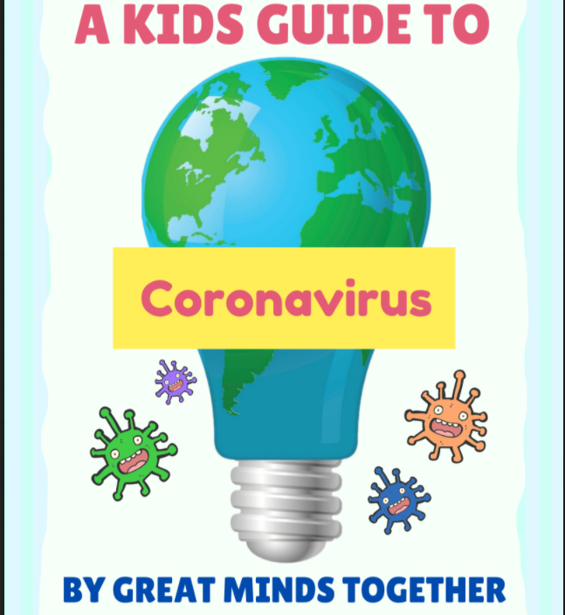
Click HERE for an alternative guide to Coronavirus

Slide 4
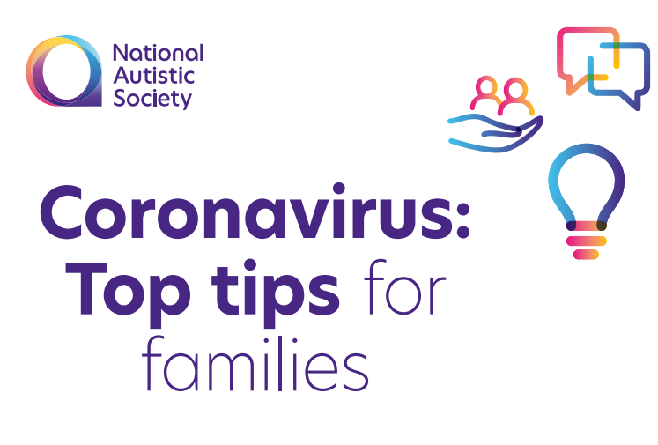
Click HERE for resources put together by the National Autistic Society to help parent's support their child's understanding of Coronavirus.

Slide 5
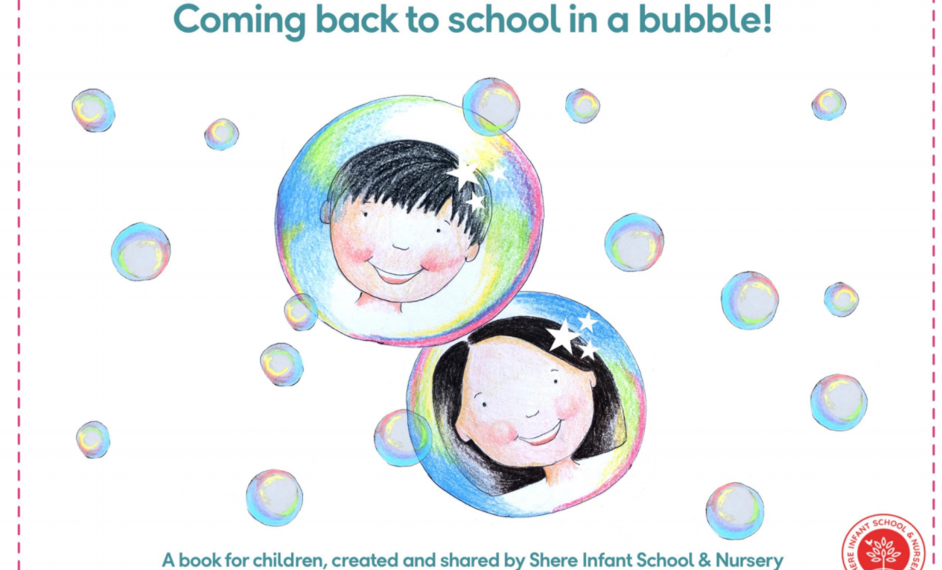
Click HERE for a book explaining 'Bubbles' for those key worker and vulnerable children who are returning to school.

Slide 6
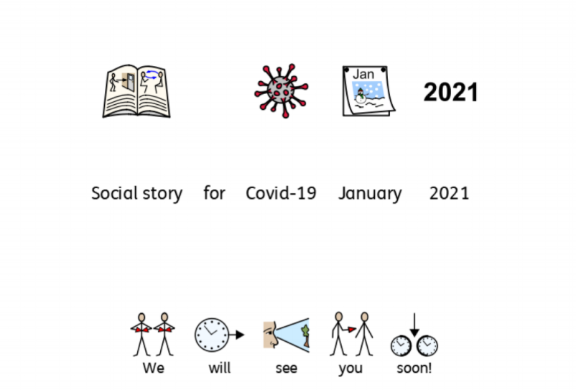
Please click HERE for a social story about Coronavirus.

