Slide 1
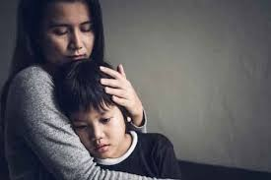
Supporting my anxious child
Children can feel anxious about different things at different ages. Many of these worries are a normal part of growing up.
From the age of around 6 months to 3 years it's very common for young children to have separation anxiety. They may become clingy and cry when separated from their parents or carers. This is a normal stage in a child's development and should stop at around age 2 to 3.
It's also common for preschool-age children to develop specific fears or phobias. Common fears in early childhood include animals, insects, storms, heights, water, blood, and the dark. These fears usually go away gradually on their own.

Slide 2

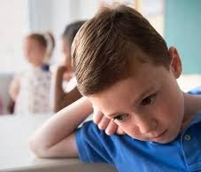
There may also be other times in a child's life when they feel anxious. For example, many children feel anxious when going to a new school or before tests and exams. Some children feel shy in social situations and may need support with this.
With all the changes in their life during the past year, it is no surprise that many children are feeling anxious at this time.
Below are some resources you might find useful to help you talk to your child about how they are feeling and support them to develop coping strategies.

Slide 3
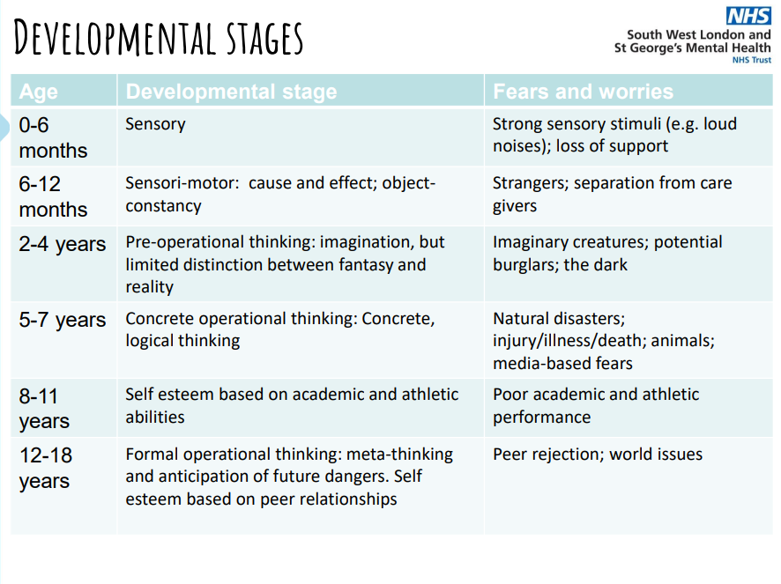

Slide 4
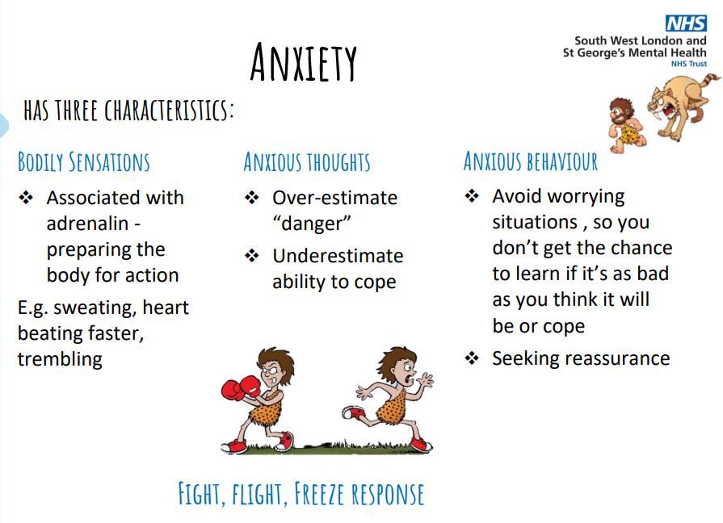

Slide 5
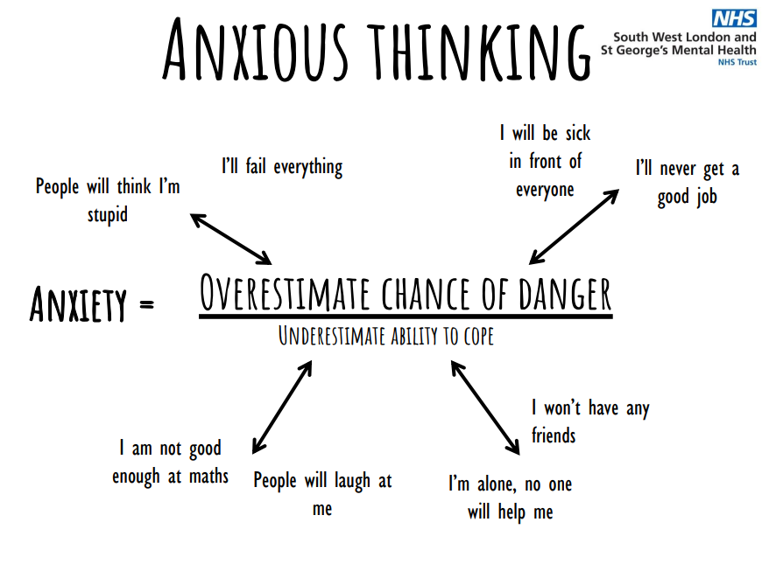

Slide 6
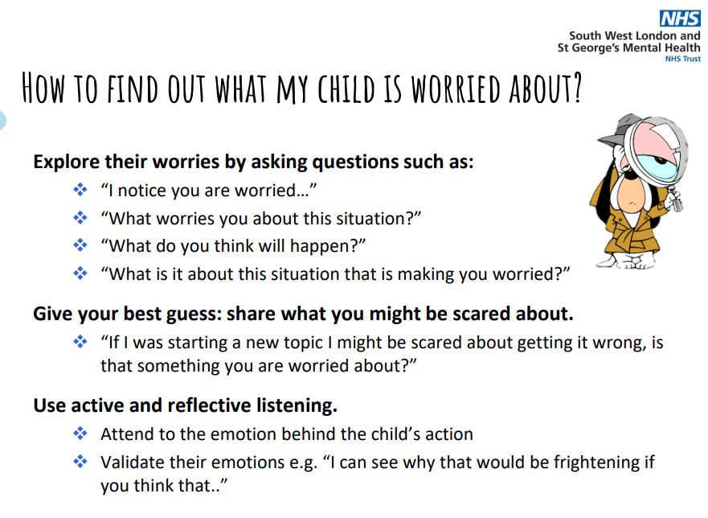

Slide 7
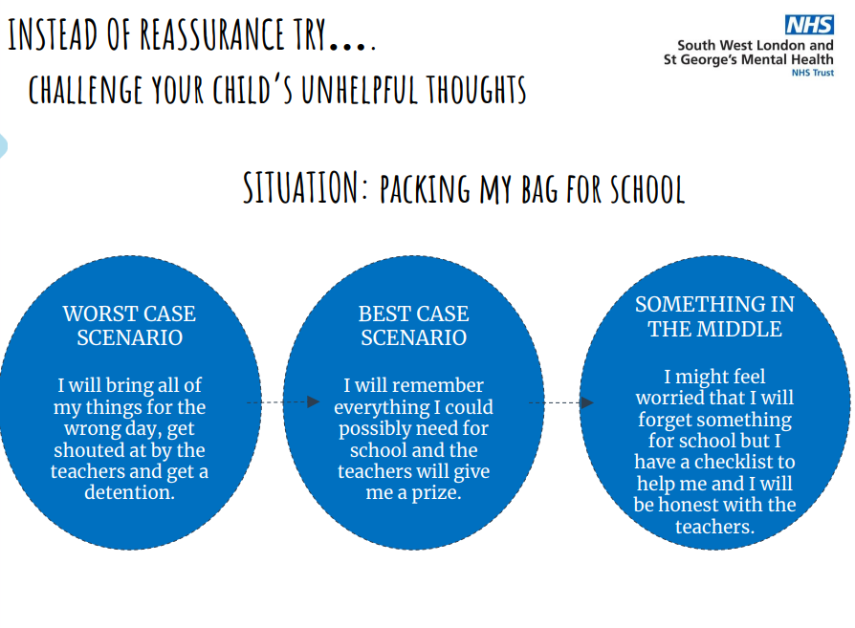

Slide 8
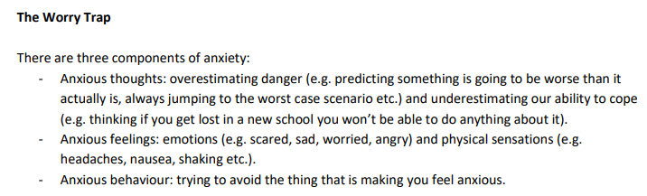
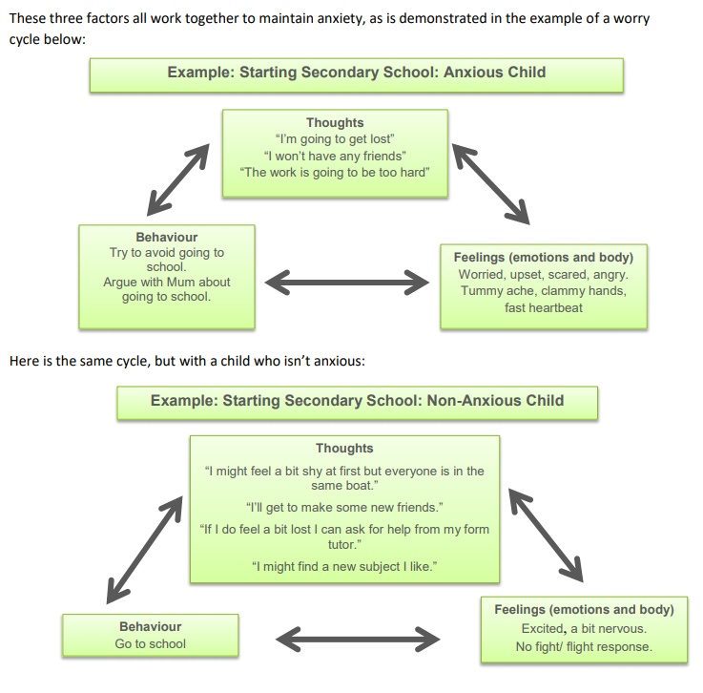
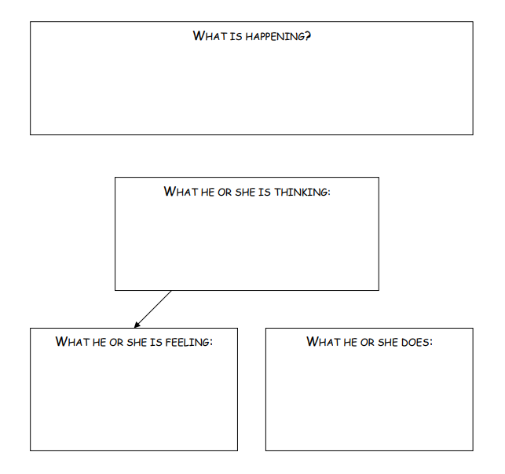

Slide 9
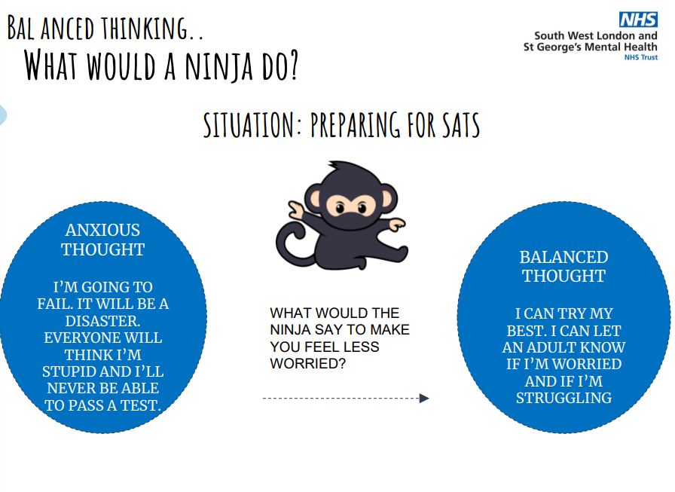

Slide 10
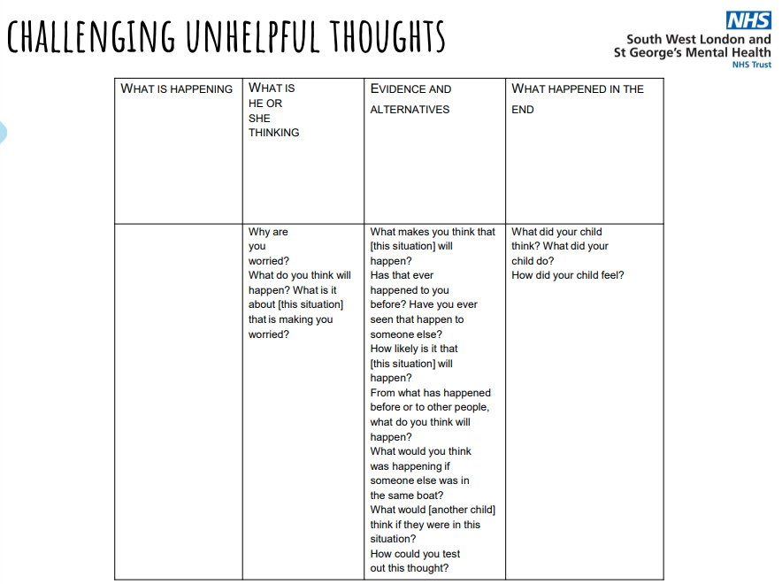

Slide 11
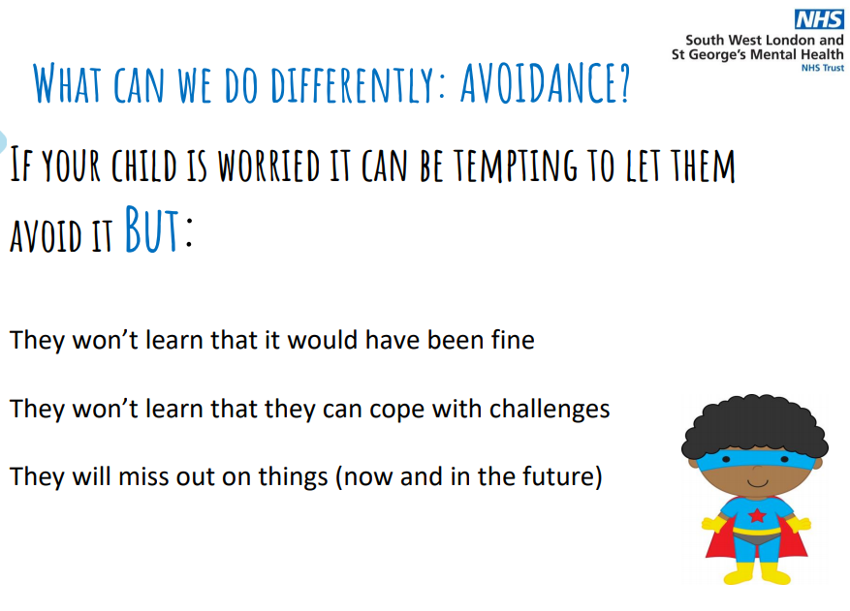

Slide 12
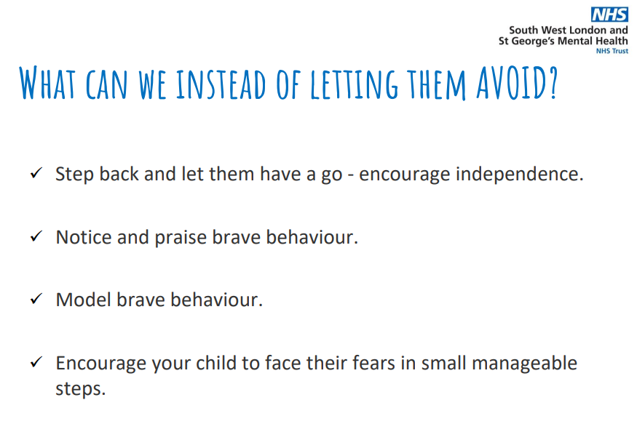

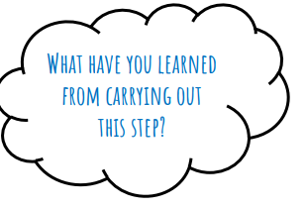
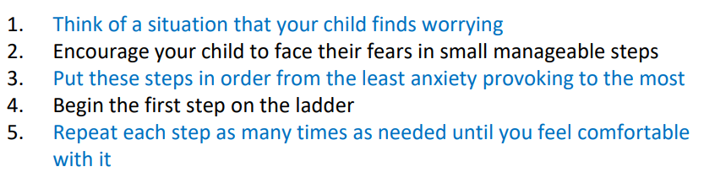

Slide 13
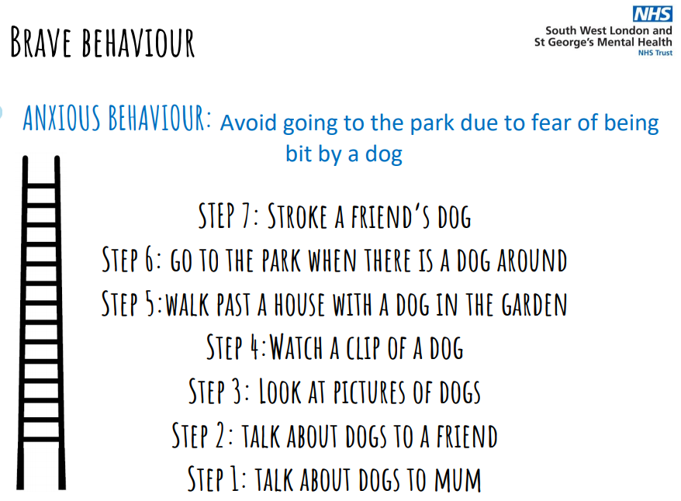
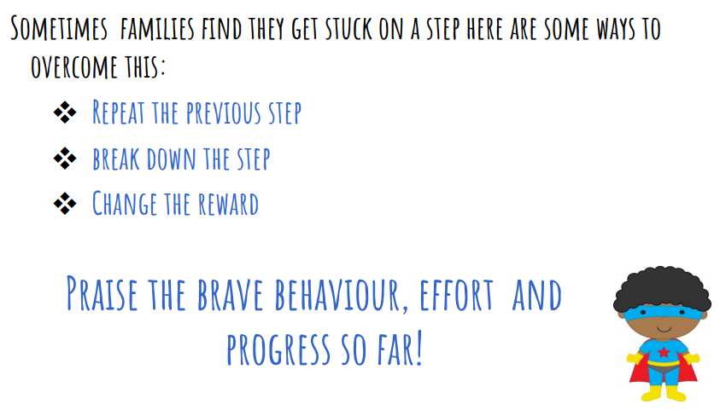

Slide 14
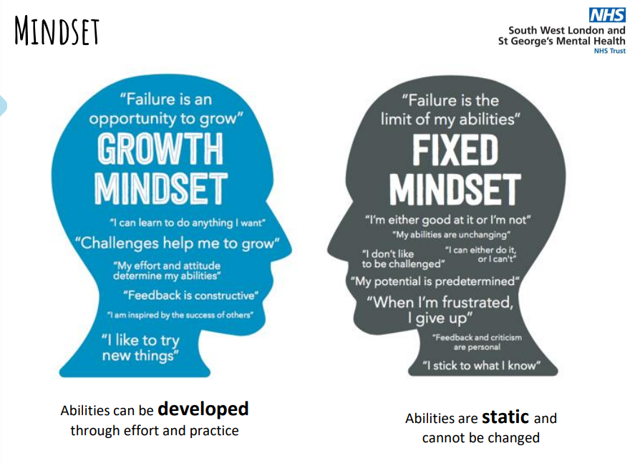

Slide 15
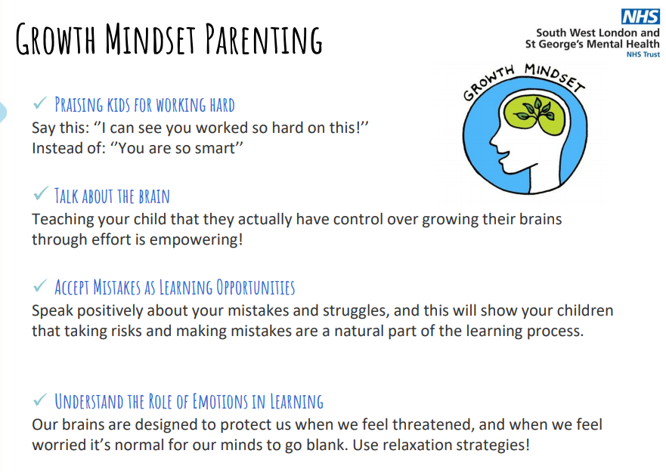

Slide 16
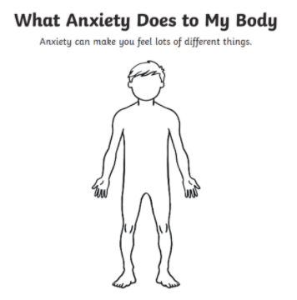
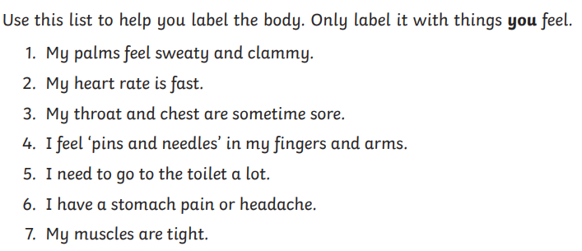
How does anxiety effect my body?
How to help your child understand what happens to their body when they are anxious?

Slide 17
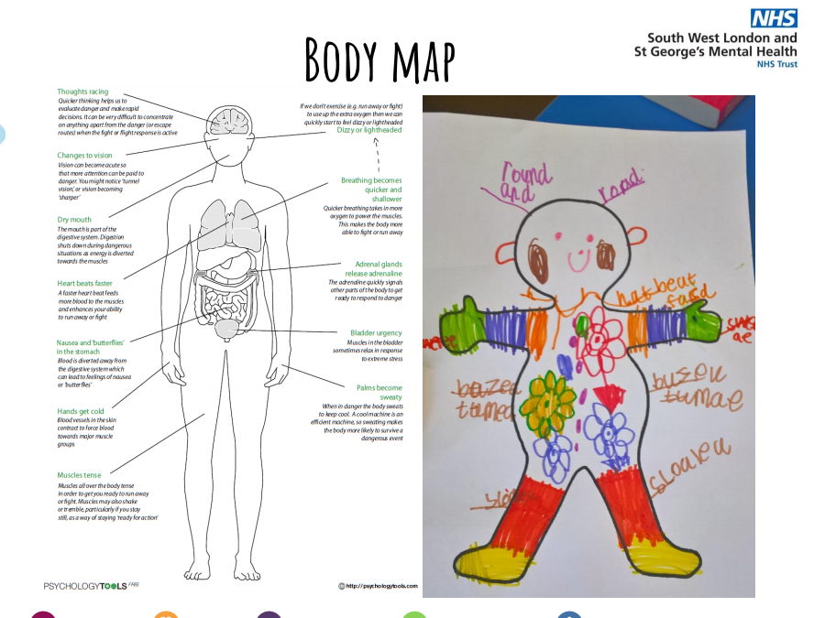

Slide 18
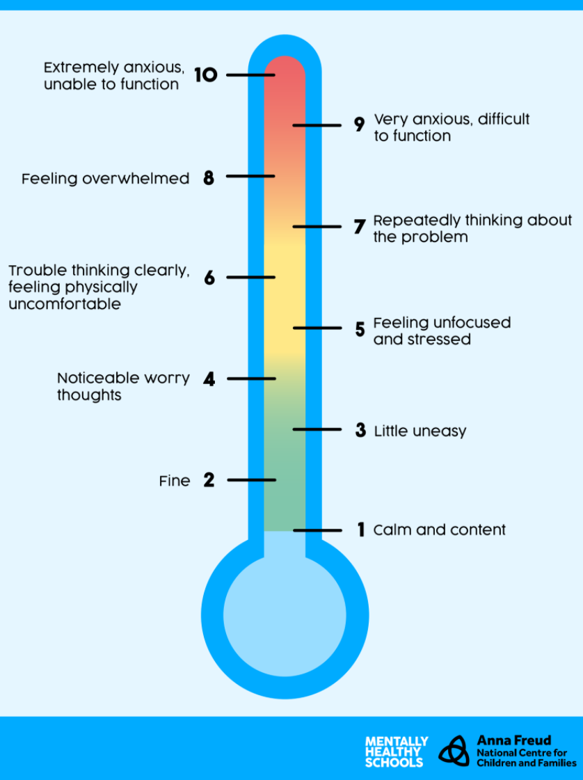
How am I feeling?
Using a feelings thermometer is a great tool to help us recognise what feelings we might be experiencing in any given moment.
Why not get your child to design a picture of themselves that they can cut out and stick on with a piece of blu tack at different points during the day. This would help your child to be aware of the feelings but also support you in knowing how they are feeling as they approach different tasks.

Slide 19
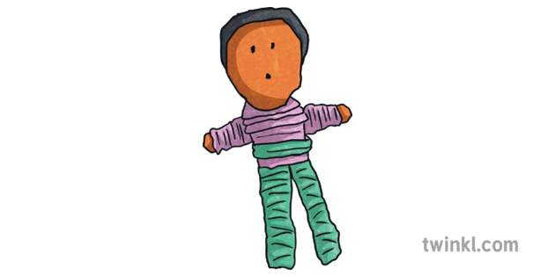
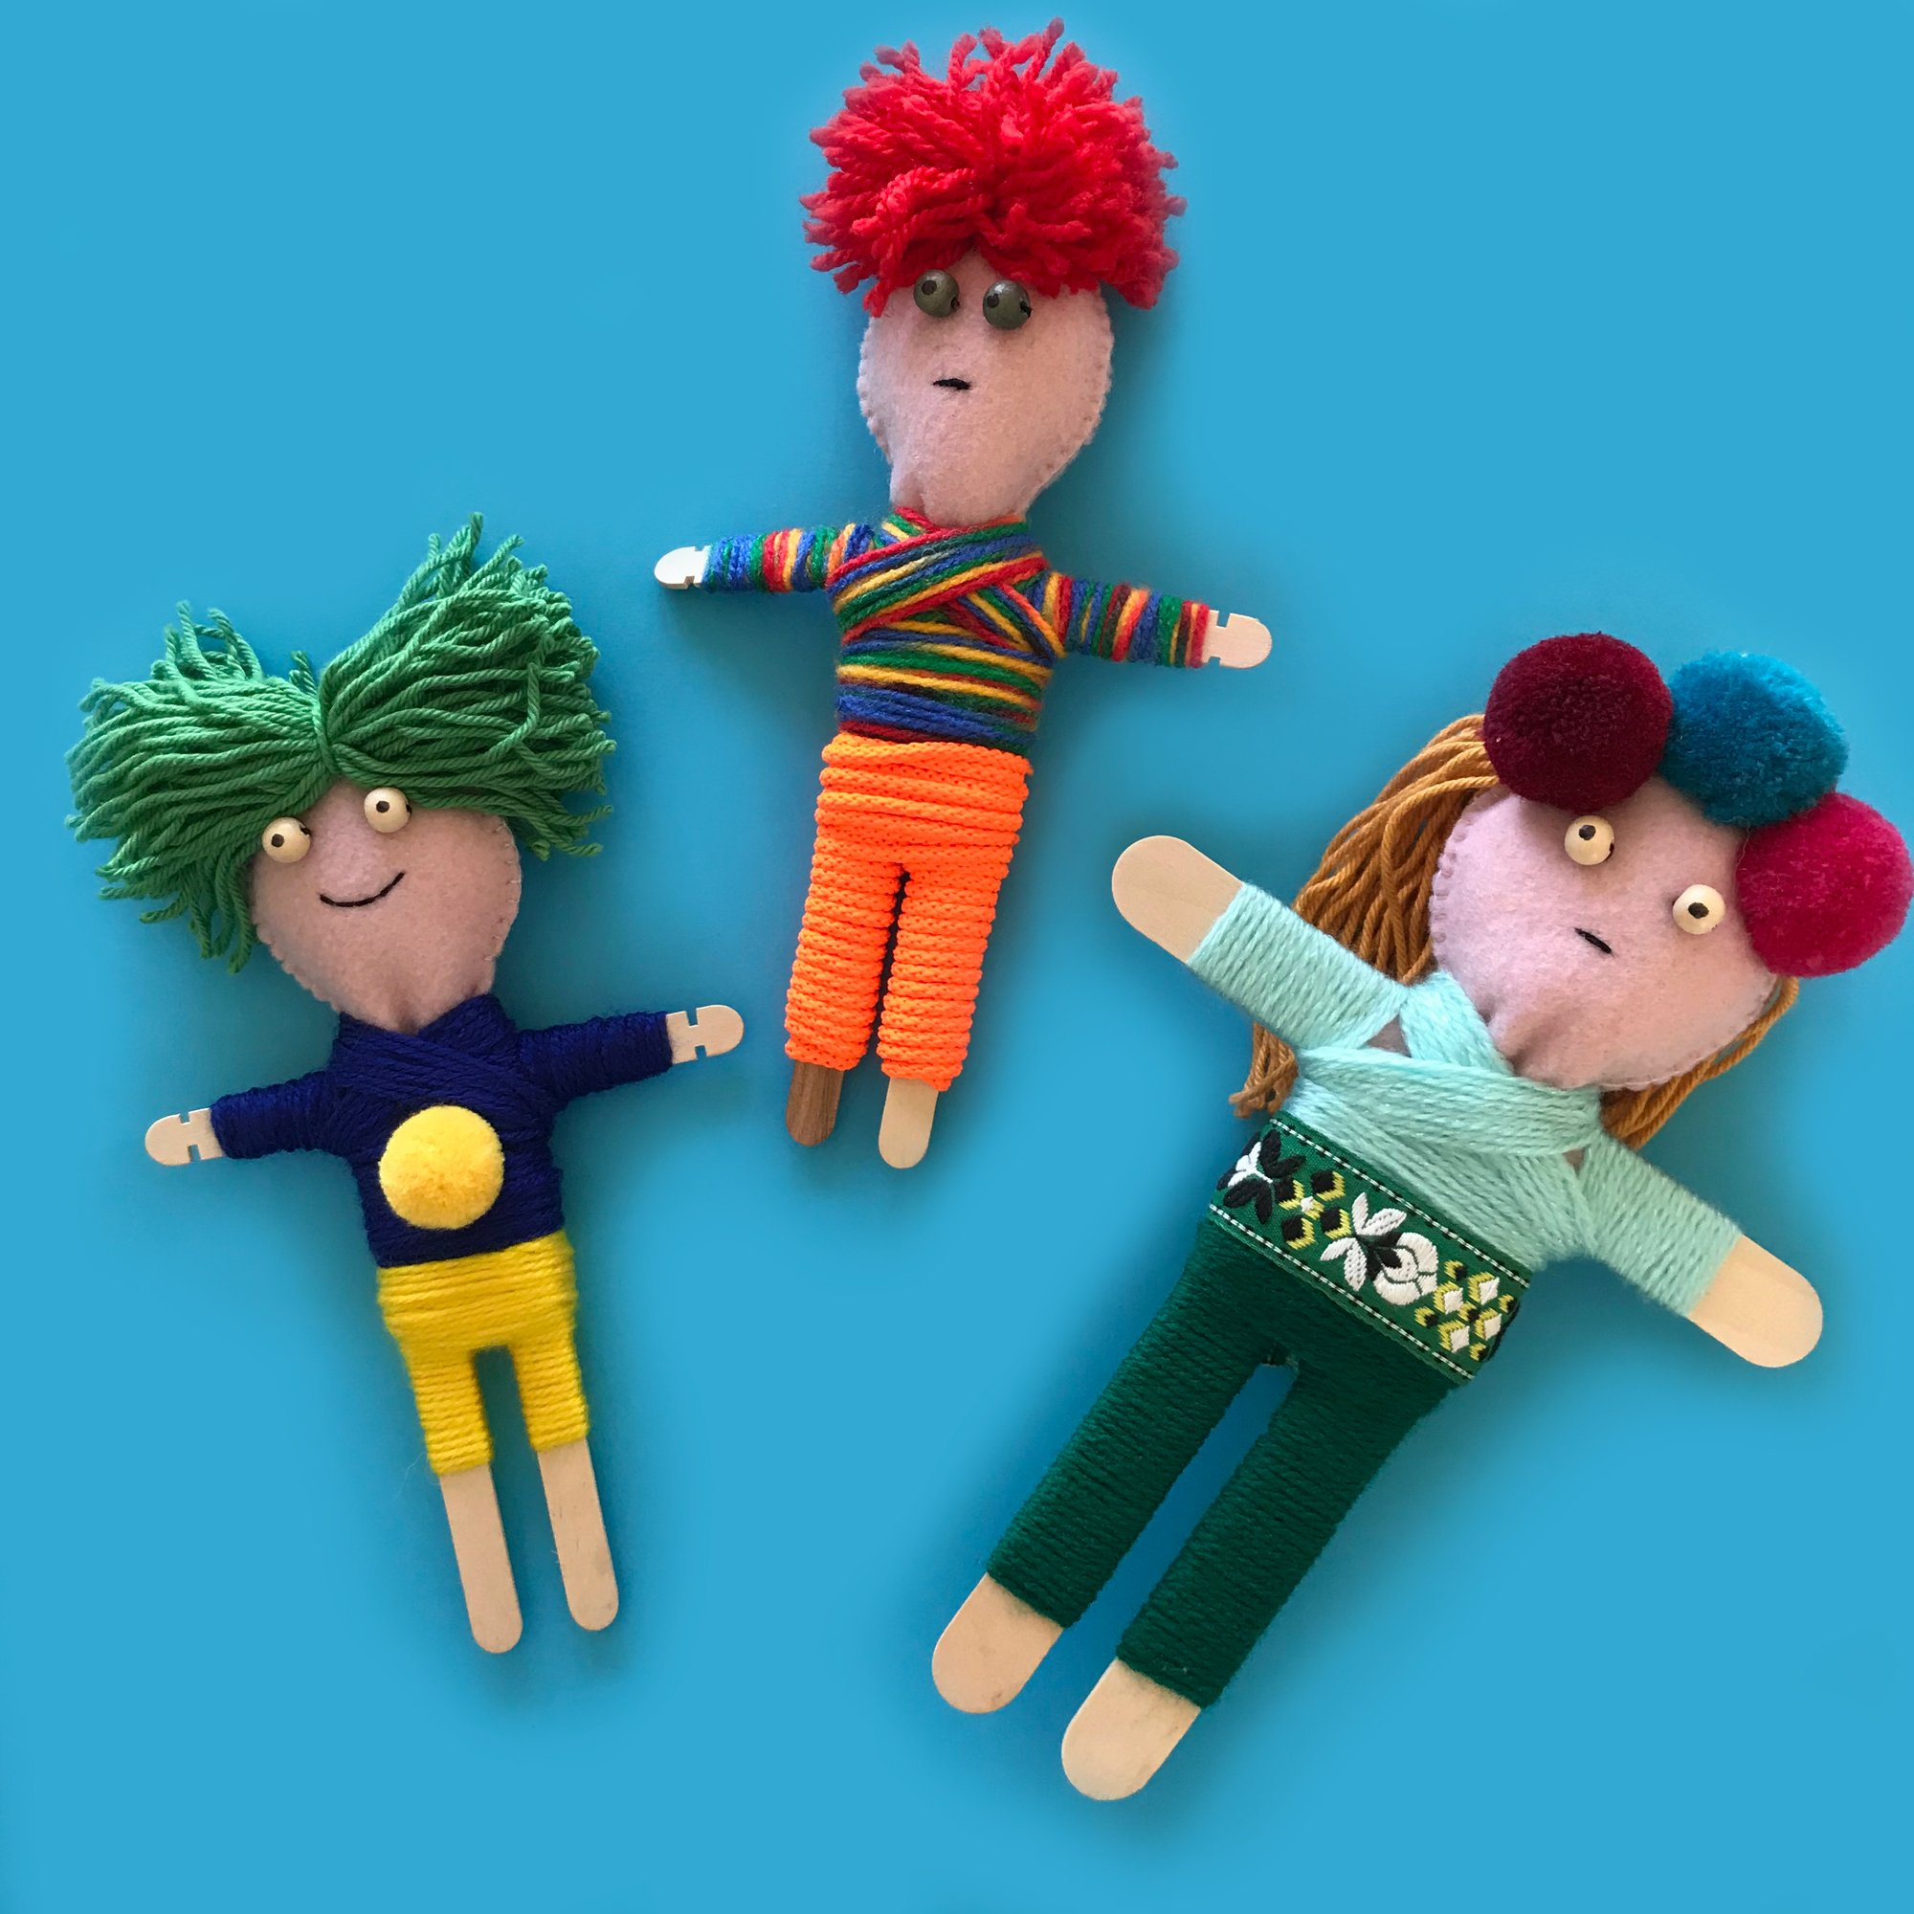
Talking about worries
How to Make Your Own Worry Doll
A worry doll is a great way of helping you to think about and manage your worries. If you
are worried about something like a test at school, moving house or a friendship difficulty, a
worry doll can help.
By sharing the worry with the worry doll, you can give yourself time to think about what is
worrying you. Sharing these thoughts with the worry doll can help you to feel better and may
even help you to solve the worry yourself.
The idea is that you share one worry with one worry doll. You tell the worry doll your worry
at night time and then put the worry doll under your pillow. Hopefully, when you wake up,
your worries will have reduced and you will feel calmer for the day ahead.
There are several ways you can make a worry doll. How you choose to make a worry doll is
entirely up to you. You could even make a worry pet or a worry animal!

Slide 20
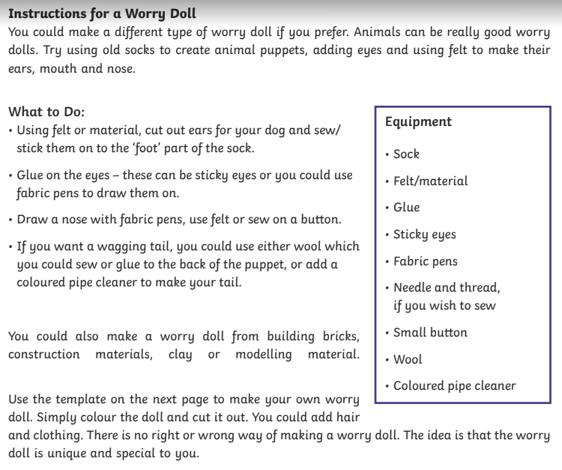
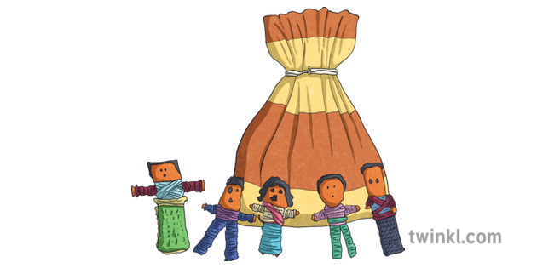

Slide 21
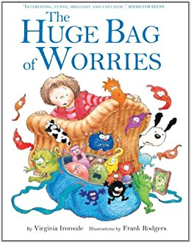

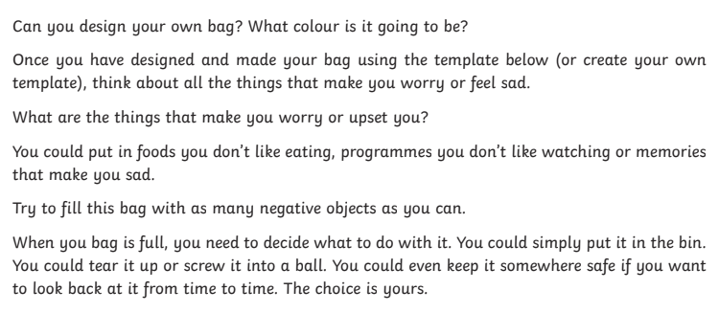

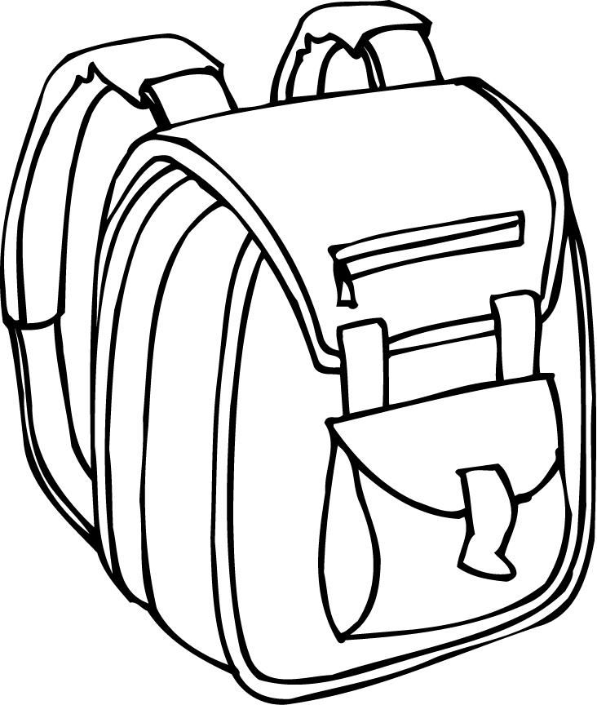


My bag of worries
Can you design your own bag?
This is a great book to read to your children.

Slide 22
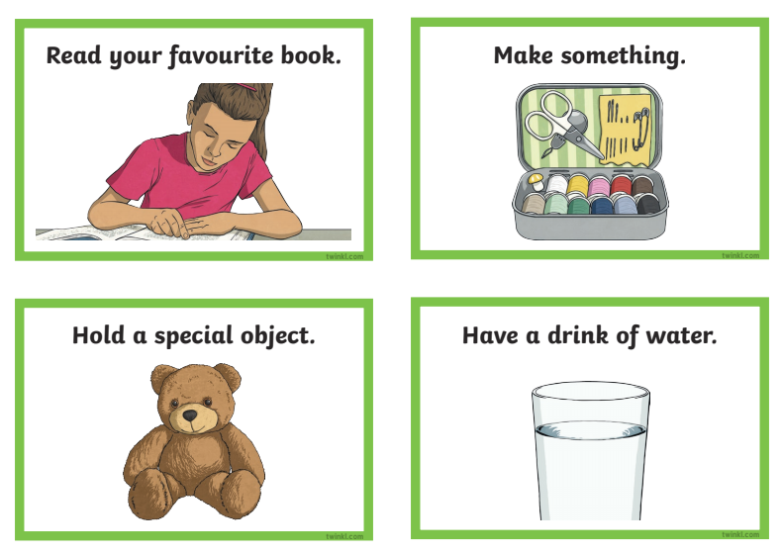
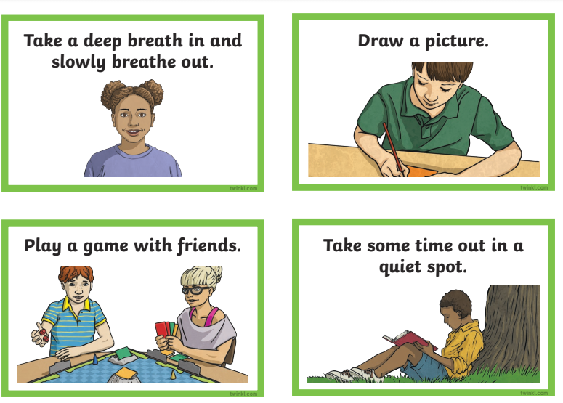
Coping Strategies
Support your child to select the cards that they think would be useful to them.

Slide 23
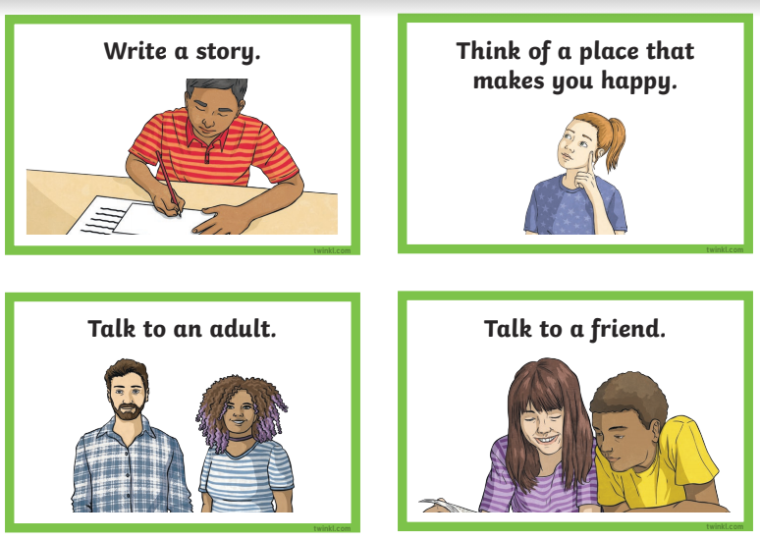

Here are some blank ones to put your own ideas on.
When a young person feels worried or is dealing with anxiety, giving them options can help them remain calm and feel in control.

Slide 24
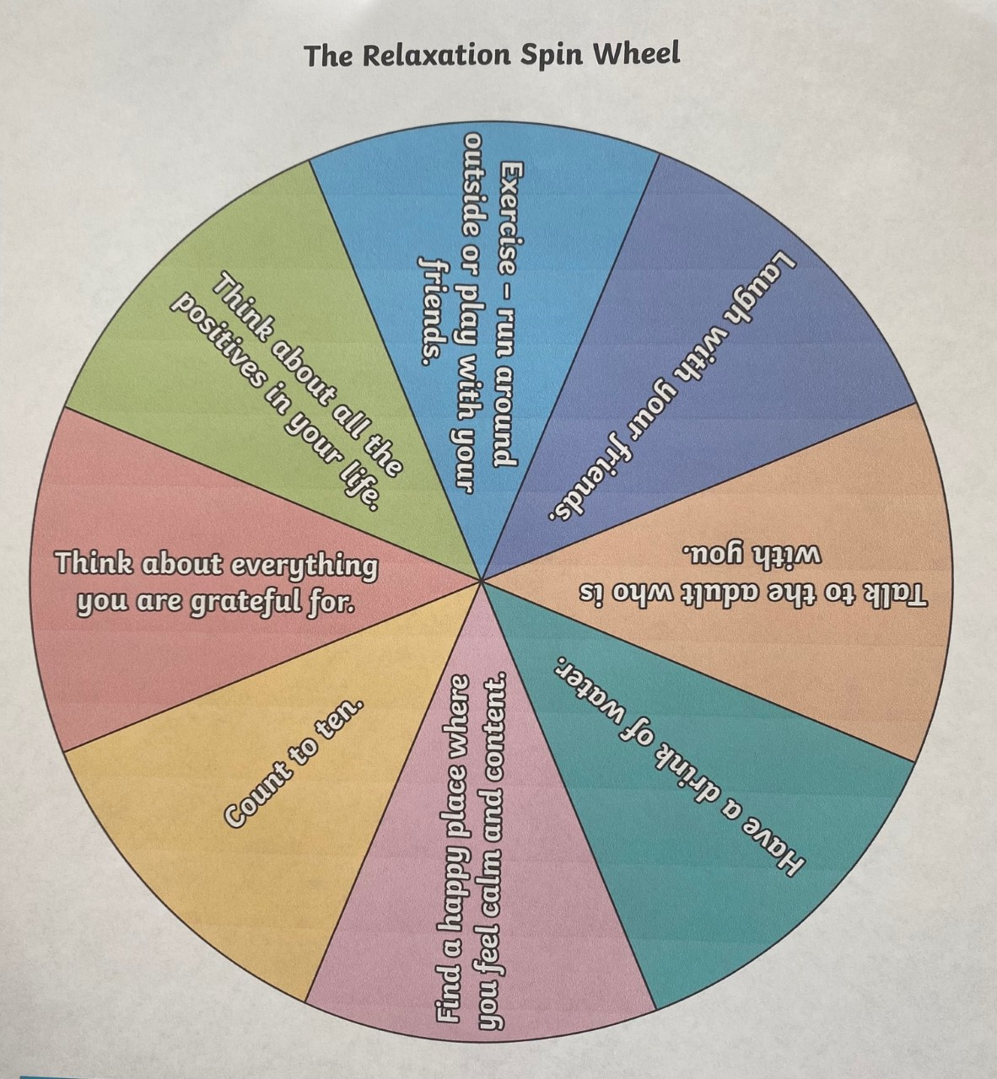
Relaxation Spin Wheel
The relaxation spin wheel is designed to give young people ideas about how to relax. This can be used to calm down after a behaviour incident or when a young person is feeling anxious or stressed.
You will need to make the relaxation spin wheel below. Please cut it out and put a split-pin in the middle. You could also paint or draw on a lazy Susan if you want to be more creative.
Encourage the young person to spin the wheel and practise doing the relaxation exercise together.
Whenever they feel anxious, they can take the relaxation wheel out of their pocket or their bag and choose which relaxation strategy to use.

Slide 25
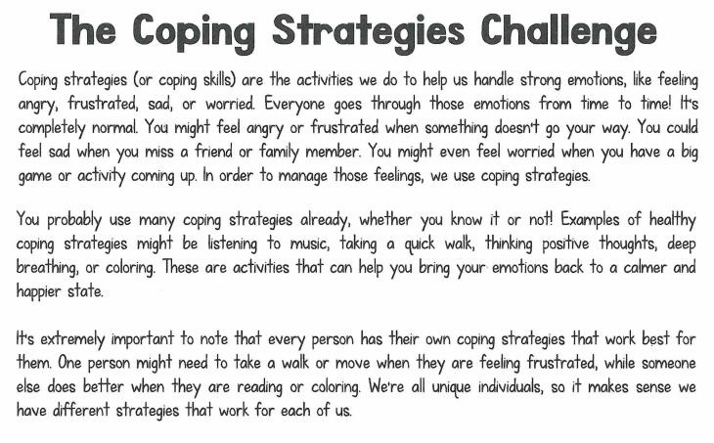

Slide 26
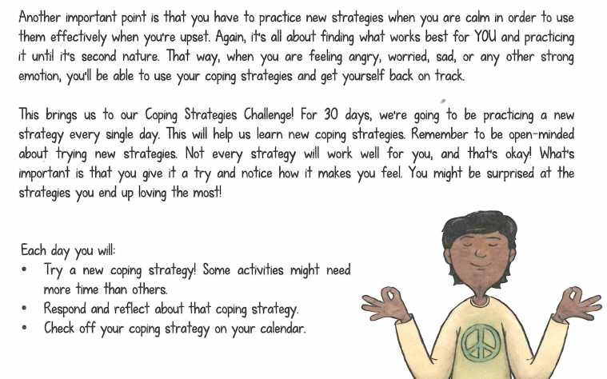

Slide 27
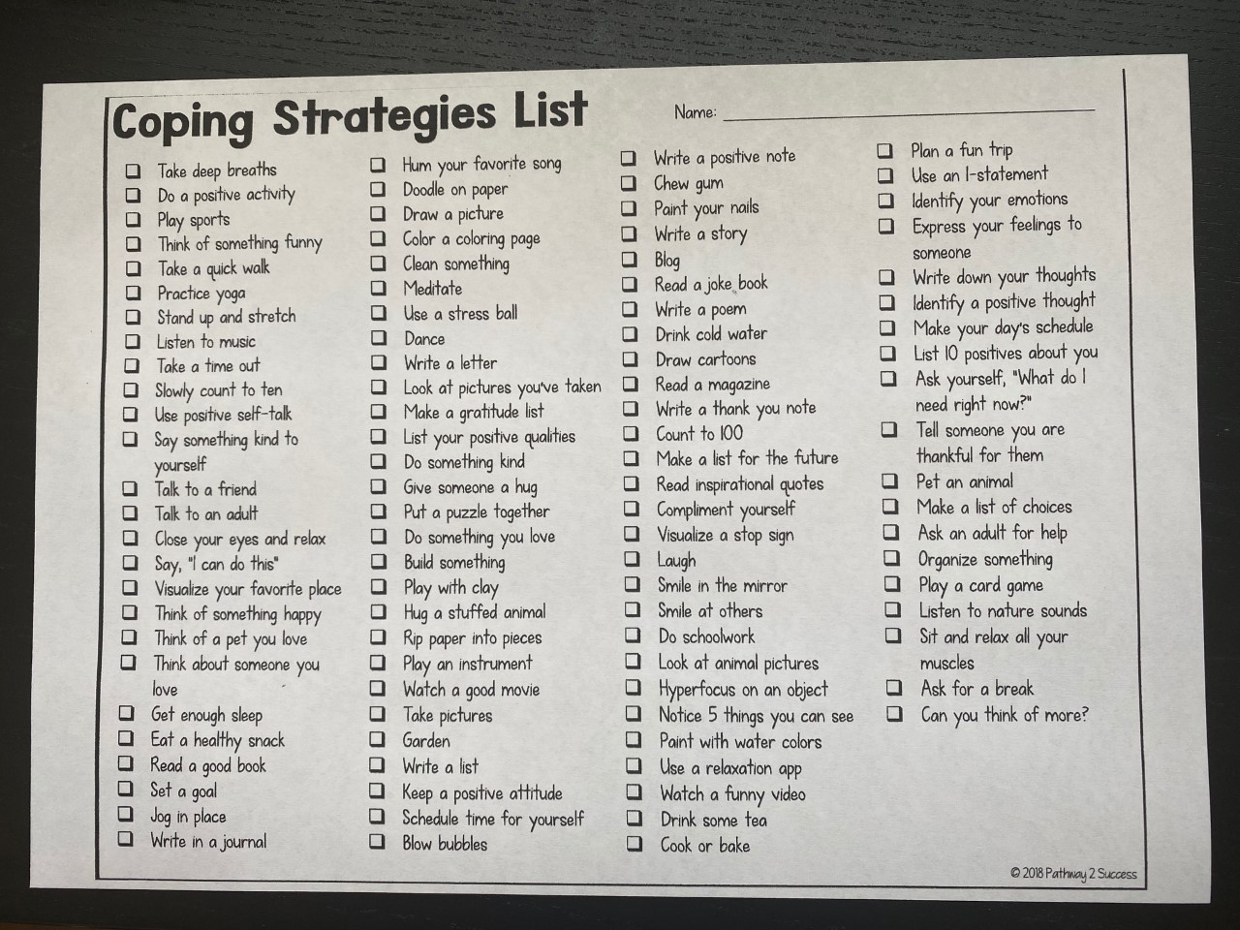

Slide 28
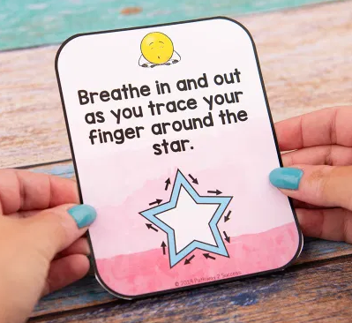
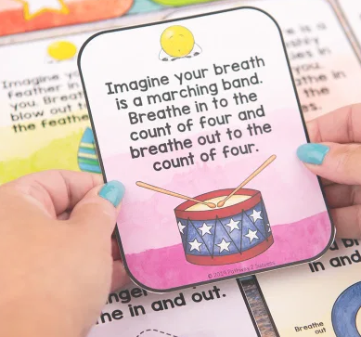
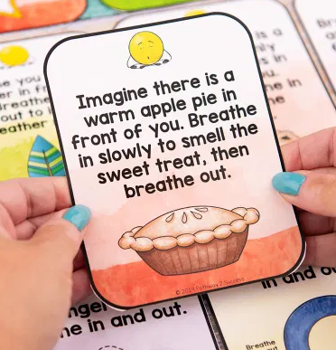
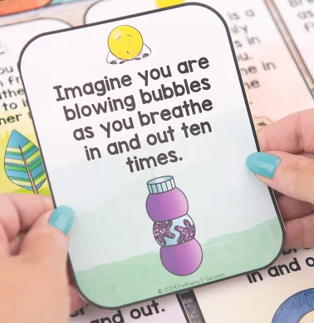
Practice mindful breathing.
By actually thinking about our breathing as we inhale and exhale, we can help control our bodies and our minds. In essence, deep breathing is a form of mindfulness. This is one of the best coping skills to teach because it is something kids can take with them wherever they go.
Practice with fun and memorable breathing exercises such as “cookie breathing.” In this breathing exercise, have students imagine that there is a tray of freshly baked cookies in front of them. Slowly breathe in to smell the cookies.

Slide 29
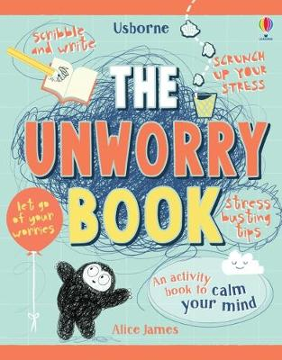
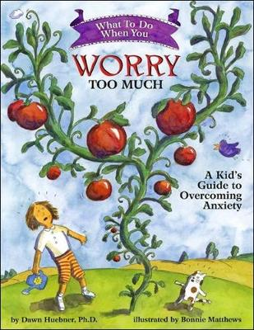
Some useful books to read with your children

