Slide 1
Curriculum Morning
Year 2

Slide 2
Welcome
Who we are
Timetable
Overview of learning
Key dates
Home learning
Helping at home

Slide 3
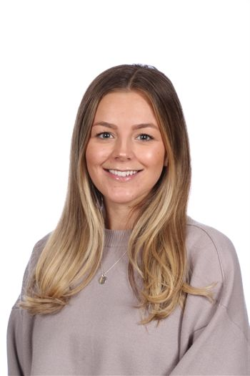
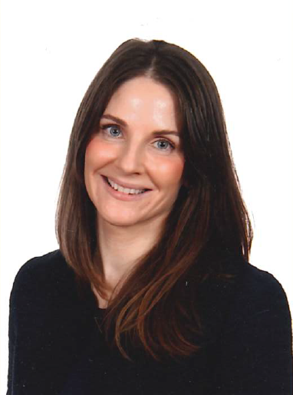
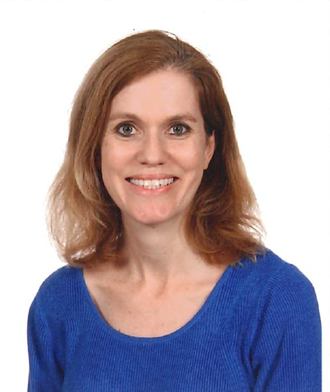
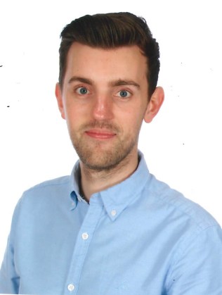
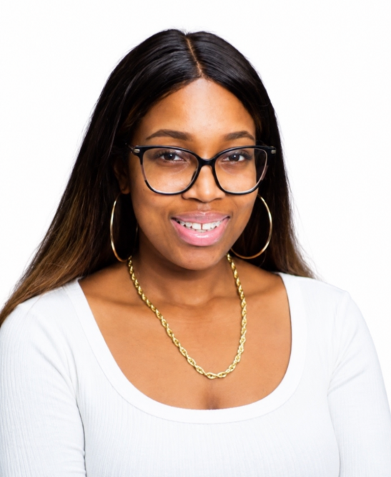
Who we are
Year 2 Sycamore class teacher Miss Finch
TA Ellie
Year 2 Mulberry class teacher Miss Bolton
TA Ros
Sarah Jones
Head Teacher
Ellen Gibson
DHT
Des Nunes
AHT & SENCO
Jonathan Pate
AHT
Adele Stewart
AHT
Notes:
Add your own photos

Slide 4
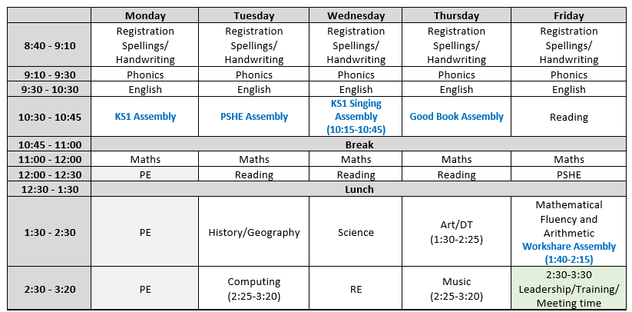
Timetable
PE days: Monday

Slide 5

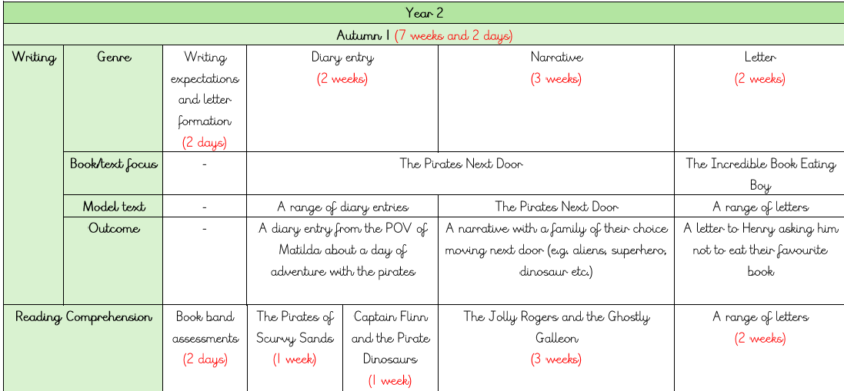



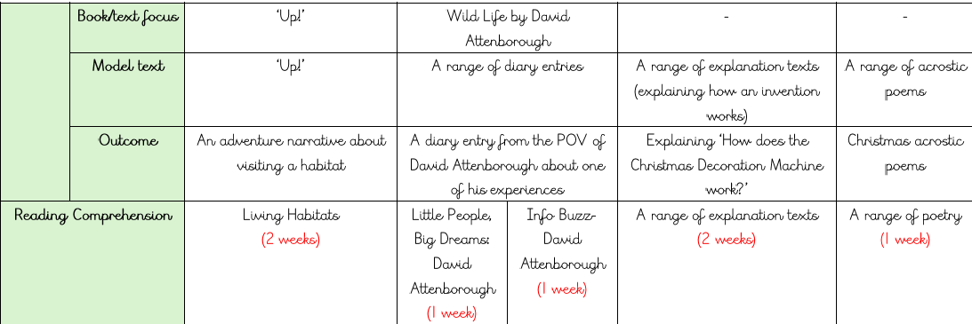
Overview of learning - English

Slide 6
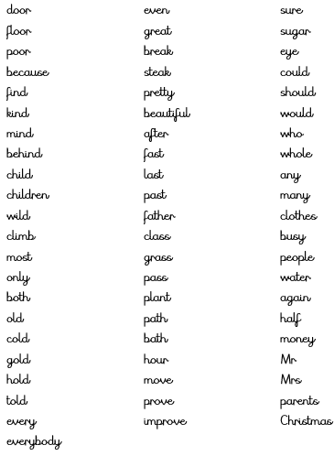
Overview of learning - English
How to help at home:
Complete homework and practice spellings, including sounding out each word.
Our spellings come from our phonics lessons – this is foundational to their English grammar.
Read every day and ask comprehension questions to engage them.

Slide 7
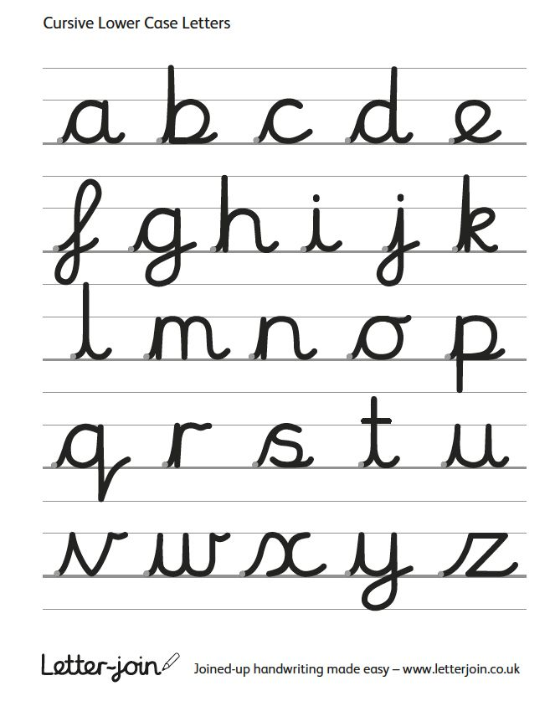
Handwriting
In year 2, our focus is to support the children in neat, cursive writing.
We practise every day, twice a day.
By the end of year 2, the expectation is for your child to join up the writing.
This will prepare them for using a pen in year 3.

Slide 8

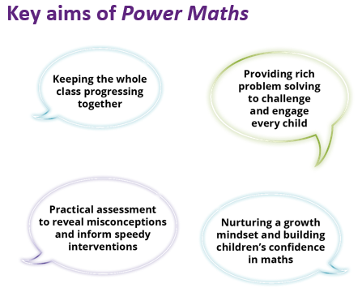

Overview of learning - Mathematics

Slide 9
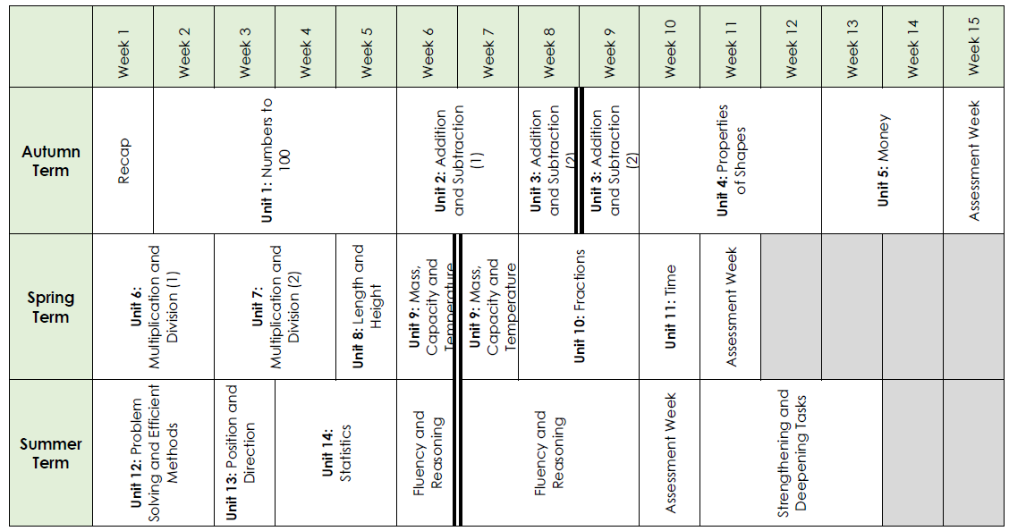
Overview of learning - Mathematics

Slide 10

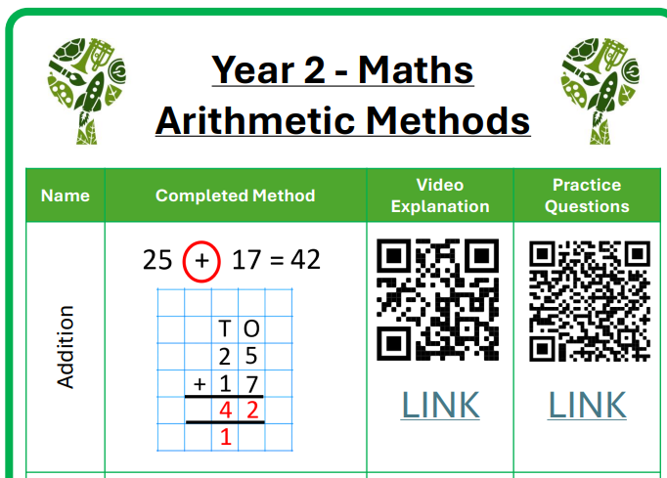
How to help at home

Slide 11
Overview of learning - Science
Autumn term:
Uses of everyday materials (Chemistry and Physics)
Living things and their habitats (Biology)
Spring term:
Animals, Including Humans (Healthy Eating)
Animals, Including Humans (Biology)
Summer term:
Plants (biology)

Slide 12
Overview of learning – Foundation subjects
Autumn -
Music, PSHE and Computing every week
Autumn 1
Art : Claude Monet (Painting and watercolours)
History: What was the Great Plague?
RE: How do Christians and Muslims express their beliefs?
Computing: Robot Algorithms
PSHE: Being Me in My World
Autumn 2
DT : Textiles – Embroidered pictures
Geography: Hot and Cold places
RE: Why is Christmas important to Christians?
Computing: Digital Photography
PSHE: Celebrating Differences
Notes:
Complete one slide per term. Talk around the highlights for each and how they link to the topic. Use the curriculum map to support this. You don’t need to read every subject.
Mention that every week the have 45 mins of Music from specialist teacher and weekly computer lessons using the ICT room.

Slide 13
Overview of learning – Foundation subjects
Spring -
Spring 1
Art: Sculpting (Traditional African masks)
RE: Can sacred books teach us anything?
History: Why was the Great Fire of London a significant event?
Computing: Computer Systems and Networks
PSHE: Dreams and Goals
Spring 2
DT: Cooking and nutrition - Soup
Geography: The UK (where would you like to live in the UK?)
RE: Why and how do people celebrate Easter and Ramadan?
Computing: Pictograms
PSHE: Healthy Me
Notes:
Complete one slide per term. Talk around the highlights for each and how they link to the topic. Use the curriculum map to support this. You don’t need to read every subject.

Slide 14
Overview of learning – Foundation subjects
Summer -
Summer 1
Art: Sketching and collage (observational drawings)
RE: Why are religious buildings sacred?
History: Mary Seacole and Florence Nightingale – How should we remember these key figures?
Computing: Making Music
PSHE: Relationships
Summer 2
DT: Structures and Systems – A chair for a bear
Geography: Africa (are our lives in Southfields like those who live in Zambia?)
RE: Should all religious people pray?
Computing: Introduction to quizzes
PSHE: Changing Me
Notes:
Complete one slide per term. Talk around the highlights for each and how they link to the topic. Use the curriculum map to support this. You don’t need to read every subject.

Slide 15
Key dates
Fulham Palace Workshop – Monday 21st September
^{Workshare assemblies:}
Sycamore– Friday 5th February 2027
Mulberry –- Friday 18th June 2027
Christmas music performance – Thursday 17th December 2026
Year 1 and 2 music assembly – Thursday 1st July 2027
Notes:
Key dates and events - Statutory testing, school journeys, anything else of interest

Slide 16
Home Learning
Home learning is given on a Friday and must be returned to school by the following Wednesday. This will consist of one of Writing, reading or maths and 6 spellings to learn.
Reading books are changed every Wednesday. We do ask you to remind them as and when they need to change their books. Please remember to sign the reading record when you listen to them read at home.
Reading records should be bought into school every Wednesday as children should be reading at home every night.

Slide 17
Helping at home
Daily reading
Spellings and handwriting
Practise times tables 2, 5, 10
Practise number bonds up to 20
Handwriting practice
Arithmetic methods on the Sheringdale website
Notes:
Rote learning practice etc

Slide 18
Thank you for coming
This presentation will be available to you on the school website. You will also find the curriculum map for the whole year on there.
If you have any questions throughout the year, please contact the office who will forward these on to us.
info@sheringdale.wandsworth.sch.uk
Enjoy the rest of your day!

