Slide 1
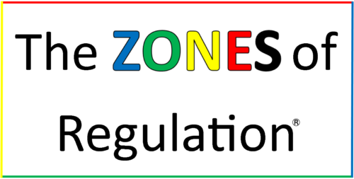

Slide 2
Who is The Zones of Regulation for?
We need to teach ALL of our children good coping and regulation strategies so that they can help themselves when they experience emotions such as anxiety or stress. Teaching children these tools at a young age will support them in later life.

Slide 3
DEFINITION OF SELF-REGULATION:
“…it is defined as the capacity to manage one’s thoughts, feelings and actions in adaptive and flexible ways across a range of contexts.” Jude Nicholas
It encompasses:
•Self-control
•Resilience
•Self-management
•Anger management
•Impulse control
•Sensory regulation

Slide 4
A person who can self-regulate is able to:
•remain CALM AND ORANISED in a stressful situation.
(Executive Functions)
•cheer themselves up after a disappointment.
(Emotional Regulation)
•knows when they are experiencing sensory overload and can make adjustments.
(Sensory processing)

Slide 5
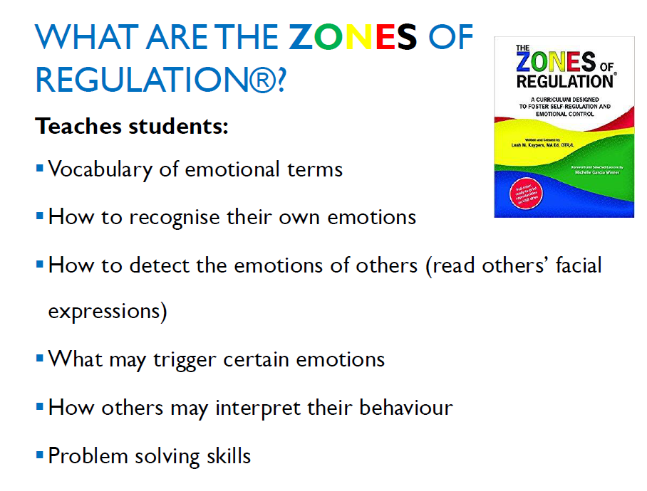

Slide 6
Some of the aims of The Zones of Regulation:
• To help children recognise when they are in the different Zones and how to change or stay in the Zone they are in.
• To gain an increased vocabulary of emotional terms so that they can explain how they are feeling.
• To gain insight into events that might make them move into the different Zones eg. disagreement with a friend, a certain subject being taught or a fire drill.
• To help children understand that emotions, sensory experiences, physiological needs (eg. hunger/lack of sleep) and environments can influence which Zone they are in.
• To develop problem-solving skills.
• To identify a range of different calming and alerting strategies/tools that support them. Tools identified may be personalised sensory supports (eg. use of putty at key times), calming techniques or thinking strategies.

Slide 7
The Zones can be likened to traffic lights:
Green: you are ‘good to go!’
Yellow: slow down or take warning
Red: stop and regain control
Blue: rest area where you pull over when you’re tired and need to recharge.

Slide 8
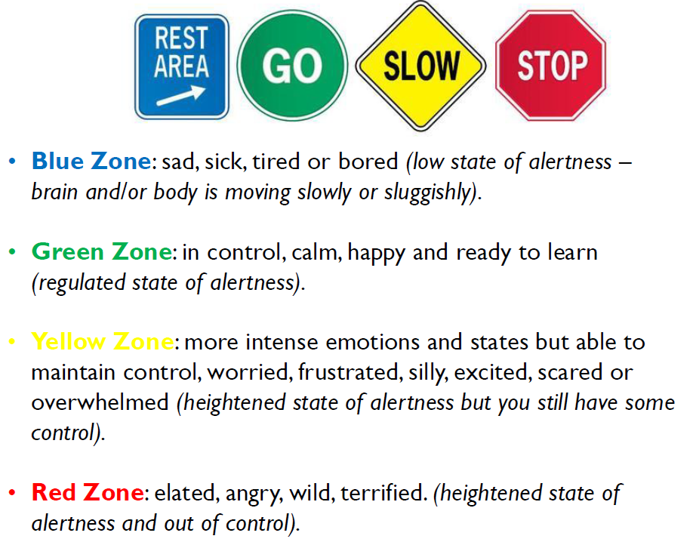

Slide 9
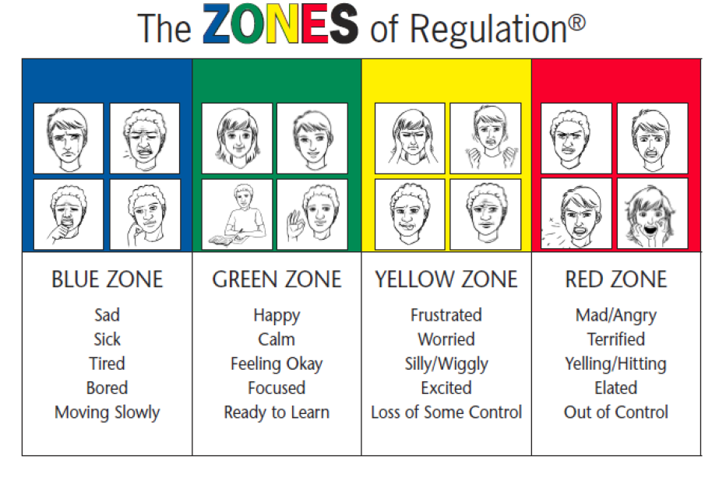

Slide 10
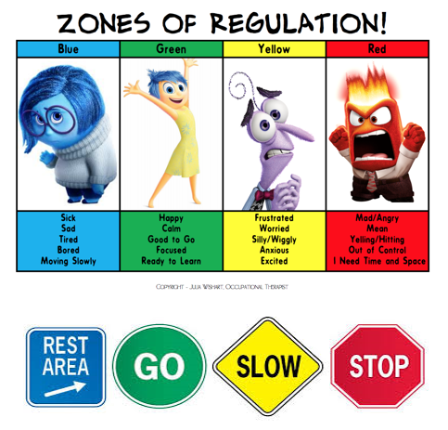
https://www.youtube.com/watch?v=L0e-oMZi000 inside out characters for the zones

Slide 11
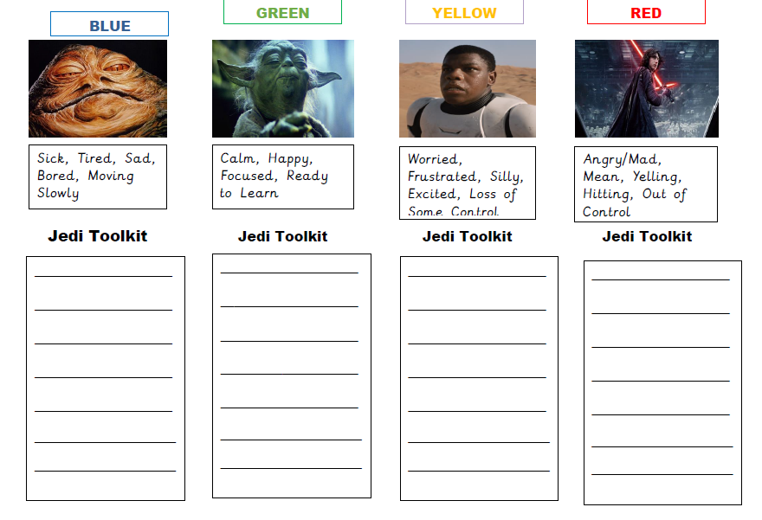

Slide 12
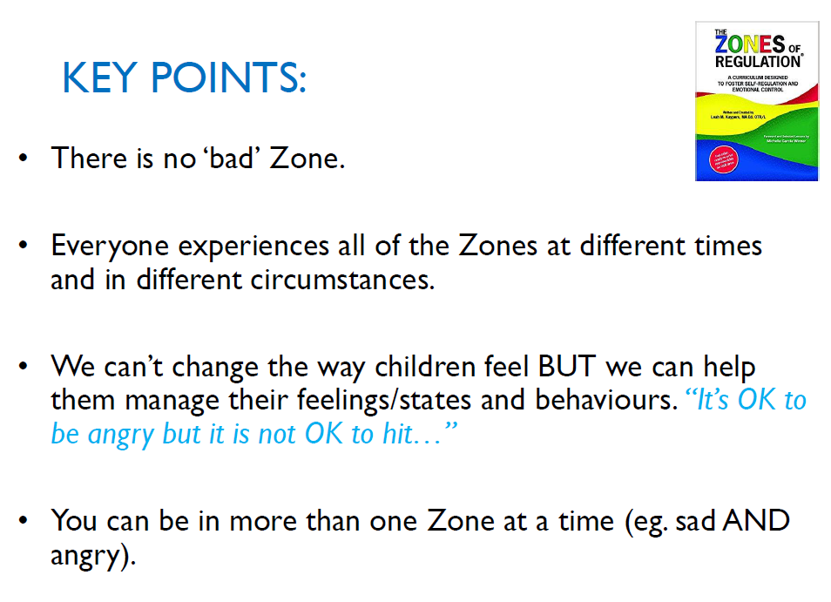

Slide 13
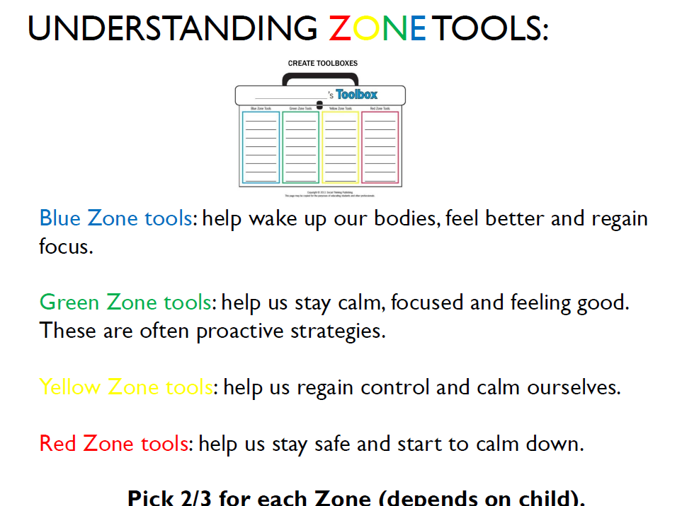

Slide 14
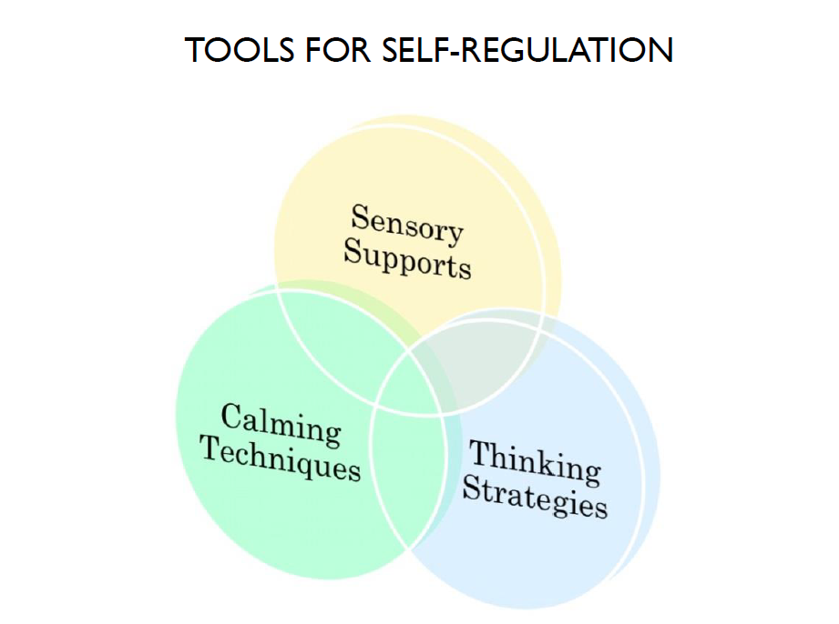

Slide 15
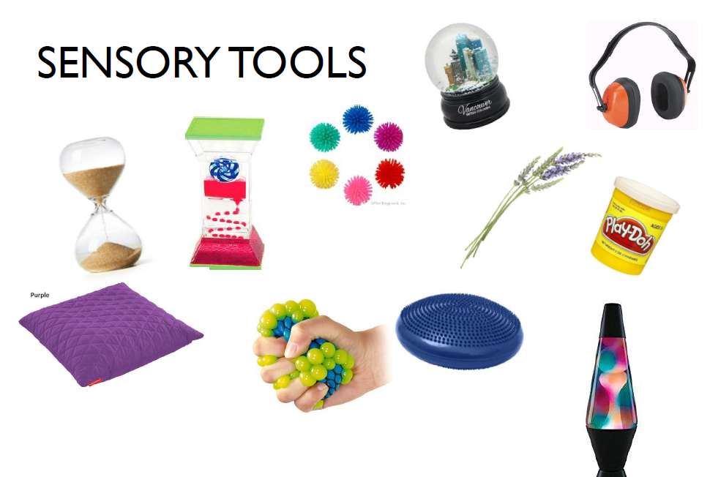

Slide 16
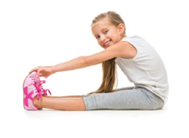
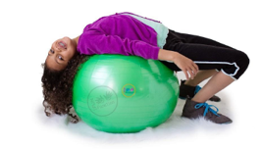


Sensory strategies
Wall push ups
Go for a walk
Blow bubbles
Roll on an exercise ball
Blanket roll
Swing or rock
Calming music

Slide 17
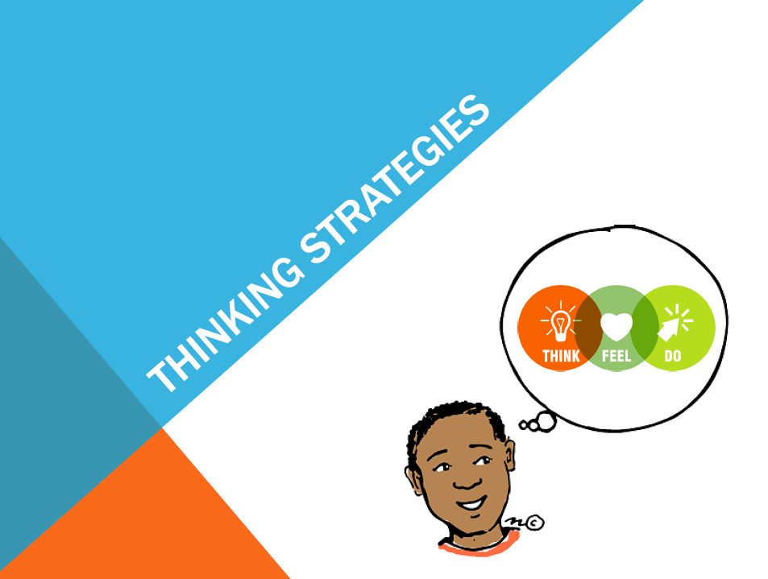

Slide 18
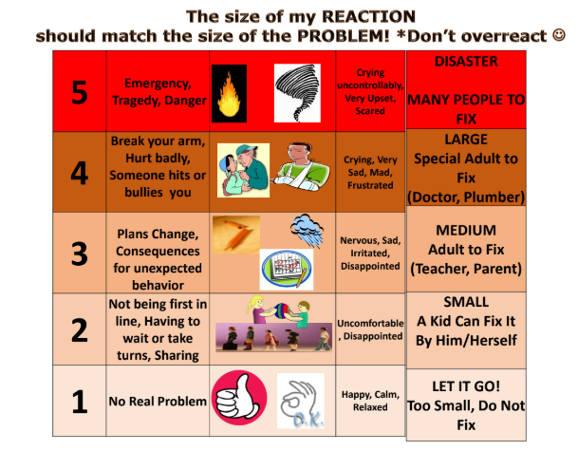
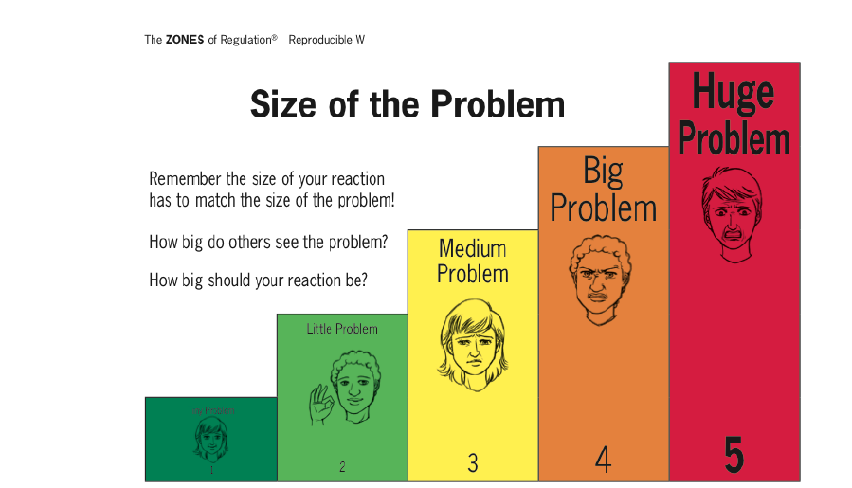

Slide 19
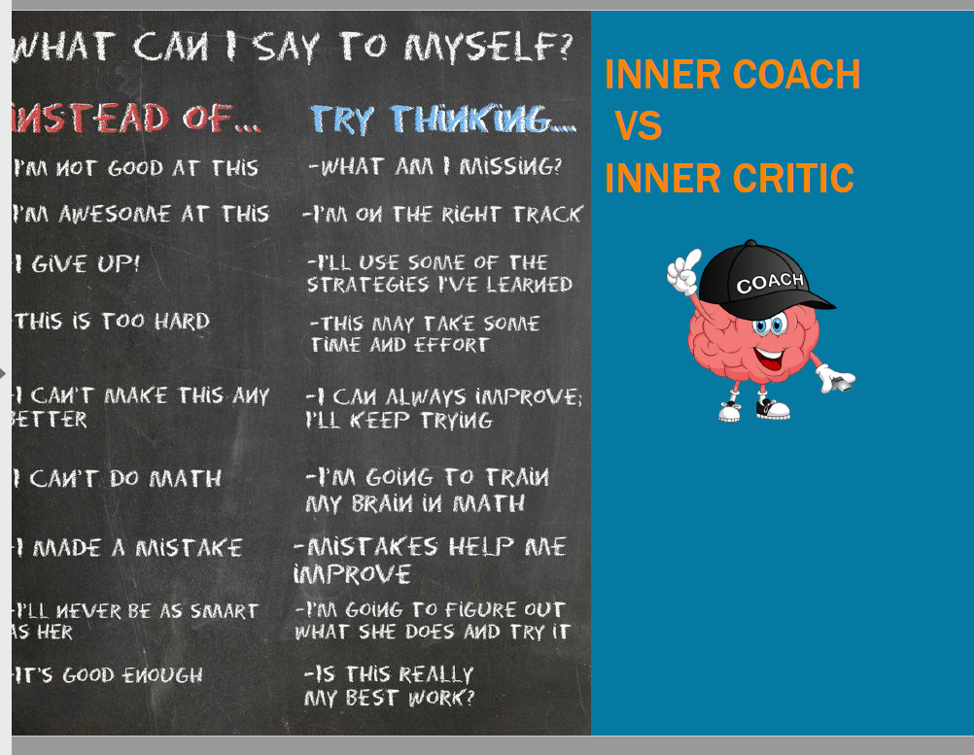

Slide 20
Inner coach
Inner coaches help us use positive self talk to give us the courage and strength to get through stressful situations.
Difficult times I may need my inner coach are: _____________________________________
My inner coach reminds me to use strategies to keep myself calm.
To help me get to the green zone, my inner coach reminds me to: ______________________________
My inner coach also helps keep positive thoughts in my head so I can be successful.
My inner coach might say to me: ________________________________________________________

Slide 21
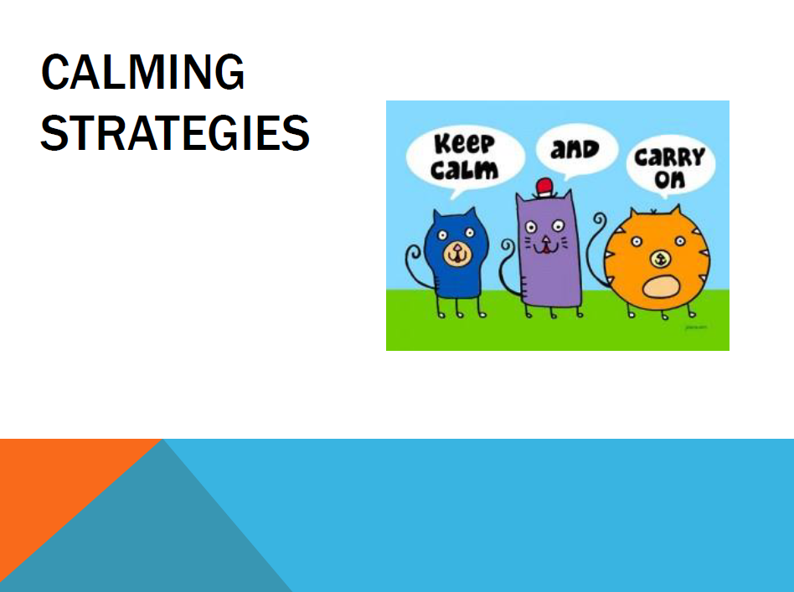

Slide 22
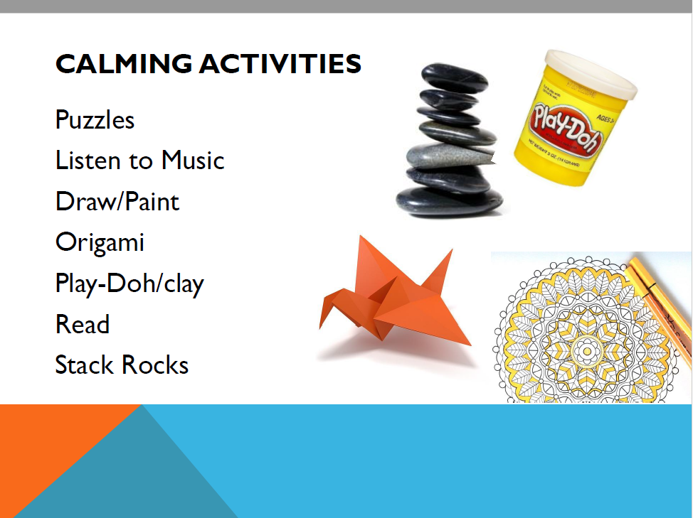

Slide 23
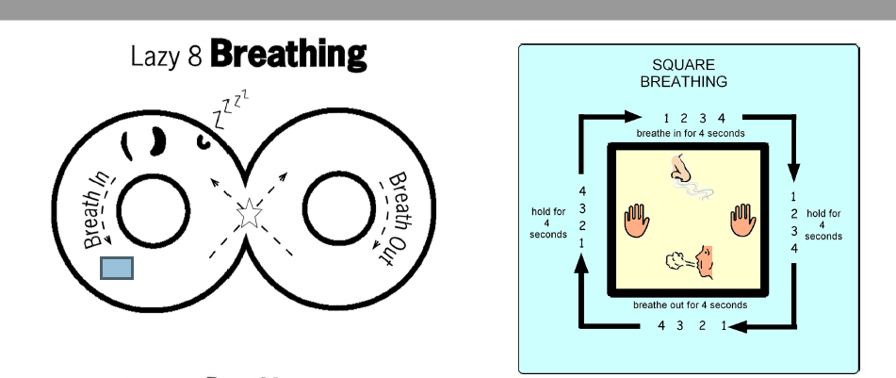

Slide 24
HOW CAN I SUPPORT THE ZONES OF REGULATION?
Identify your own feelings using Zones language in front of your class (e.g. “I’m frustrated, I am in the yellow zone”)
Provide positive reinforcement when a child is in the Green Zone and if they make efforts to stay in the Green Zone. Eg. “I can see you are working really hard to stay in the Green Zone.
Talk about what tool you will use to be in the appropriate Zone. (e.g. “I’m feeling frustrated so it might be a good idea for me to squeeze some putty to help me calm down” )
Label what zones a child is in throughout the day (e.g. “You look sleepy, are you in the blue zone?”)
Post and reference the Zones visuals and tools in your classroom.

Slide 25
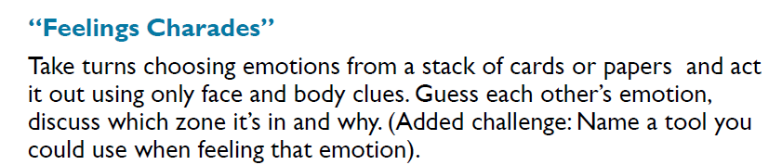
Learn the song!
https://www.youtube.com/watch?v=Vnl3GeTkMa4

Slide 26


