Slide 1
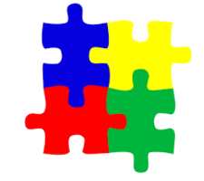
The ZONEs of regulation
Session one

Slide 2
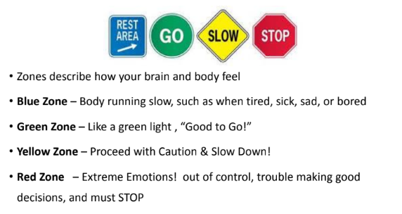
Notes:
There are 4 zones blue green yellow and red that your feelings fit into.
The Zones can be compared to traffic signs. When given a green light or in the Green Zone, one is “good to go”. A yellow sign means be aware or take caution, which applies to the Yellow Zone. A red light or stop sign means stop, and when one is the Red Zone this often is the case. The Blue Zone can be compared to the rest area signs where one goes to rest or re-energize

Slide 3
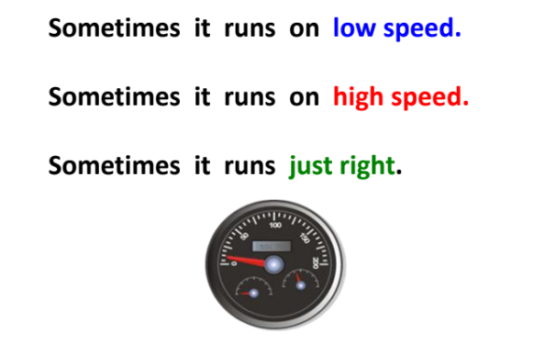
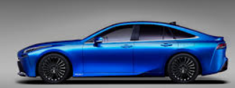
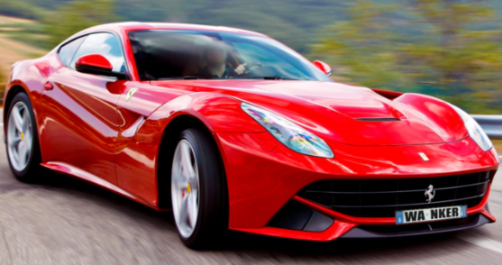
How does your car run?
Notes:
If we think of ourselves as a car? We go at different speeds slow (blue) and fast (red) but green is the perfect speed.
The Zones can be compared to traffic signs. When given a green light or in the Green Zone, one is “good to go”. A yellow sign means be aware or take caution, which applies to the Yellow Zone. A red light or stop sign means stop, and when one is the Red Zone this often is the case. The Blue Zone can be compared to the rest area signs where one goes to rest or re-energize

Slide 4
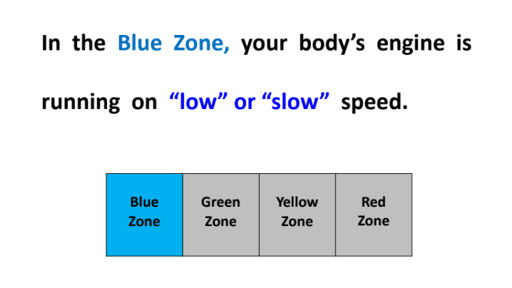
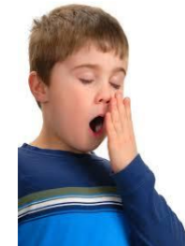
Notes:
The Blue Zone is used to describe low states of alertness and down feelings such as when one feels sad, tired, sick, or bored.

Slide 5
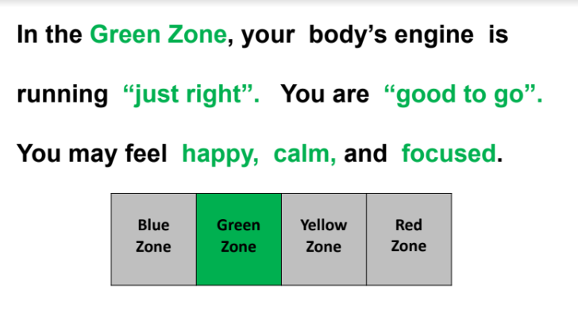

Notes:
The Green Zone is used to describe a calm state of alertness. A person may be described as happy, focused, content, alert or ready to learn when in the Green Zone. This is the zone where optimal learning occurs. The perfect learning mood.

Slide 6
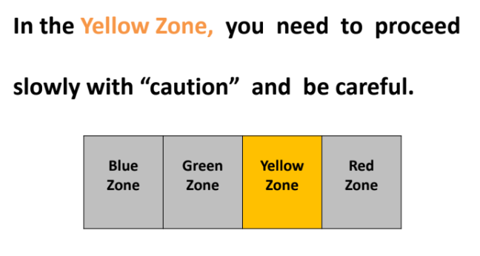
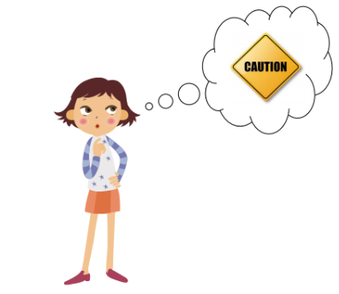
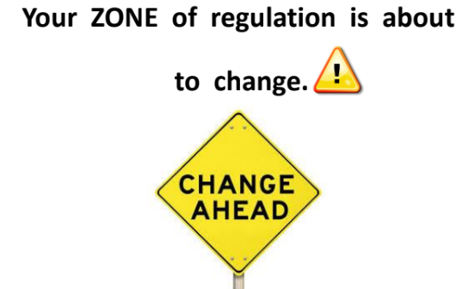
Notes:
also used to describe a heightened state of alertness and elevated emotions, however one has more control when they are in the Yellow Zone. A person may be experiencing stress, frustration, anxiety, excitement, worried, anxious, silly, illiness, the wiggles, or nervousness when in the Yellow ZoneIn the yellow zone - a change is coming! You are on the edge. Either go to the out of control red zone or back to the calmer green zone,

Slide 7
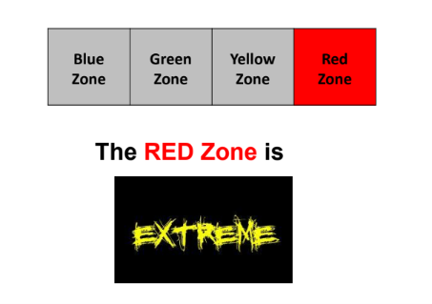
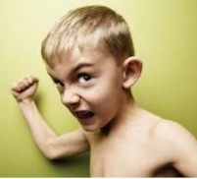
Notes:
The Red Zone is used to describe extremely heightened states of alertness and intense emotions. A person may be elated or experiencing anger, rage, devastation, or terror when in the Red Zone. In the red zone, your body engine is running on high speed, you have trouble making, good decisions and must stop!

Slide 8
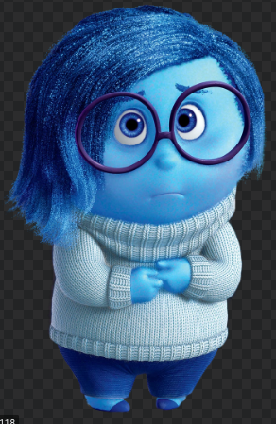
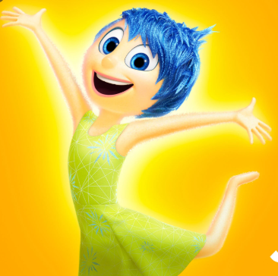
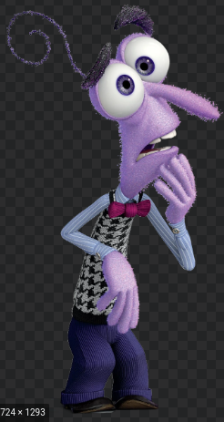
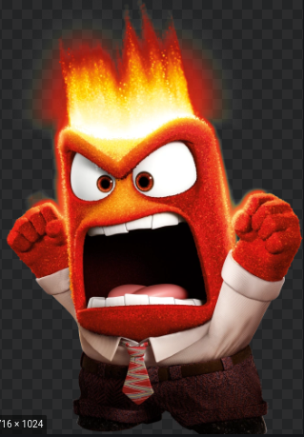
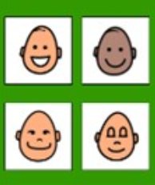
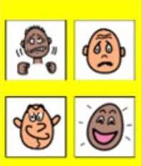
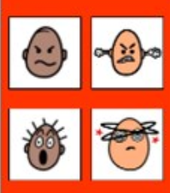
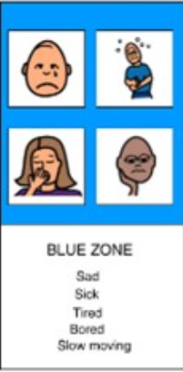
Sad
Sick
Tired
Bored
Slow moving
Happy
Calm
Good to go!
Focused
Ready to learn
Frustrated
Wriggly/ Silly
Worried
Excited
Loss of some control
Mad/ angry
Mean
Terrified
Yelling hitting
Out of control
Notes:
Recap on the 4 zones
None of the zones are bad zones

Slide 9
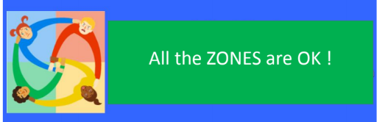
Which ZONE would Is it in?
All of the zones are okay. There are times when you will be in different zones. Think about times you are expect to be in Blue, green, yellow or red zone.
Notes:
We have all been in all of the zonesby now

Slide 10

More Than One ZONE
You can be in more than one zone at once.
(e.g. Blue for Tired and Yellow for Anxiety over a test)
The same emotion can be categorized into different zones
(e.g. Disappointment in Blue or Yellow & Jealous can be Yellow or Red)
Notes:
Listing more than one Zone could mean your really in touch with
Your feelings and alertness level.

Slide 11
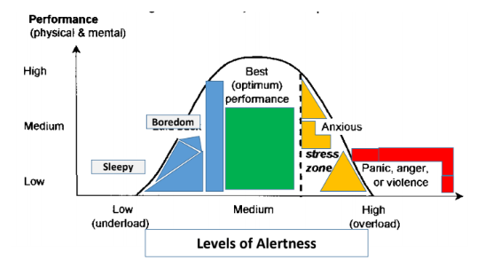
In the green zone you get the best work done!

Slide 12
What zone is it in?
https://www.youtube.com/watch?v=L0e-oMZi000 inside out characters for the zones
Notes:
You could play bingo and get children on whiteboard to divide board into sy 4 sections and write some feelings in ( from slide earlier) and play bingo! Could talk about book and film characters and what zones they would be in, so they can identify what other people look like in these zones.

Slide 13

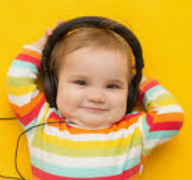
What are they feeling?
What zone are they in?
Notes:
Happy

Slide 14
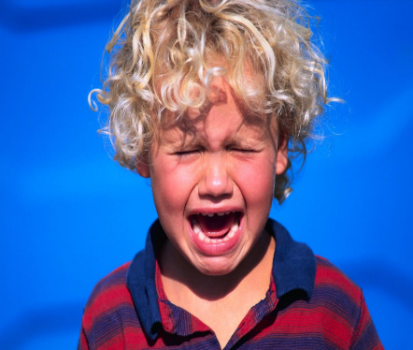
What are they feeling?
What zone are they in?
Notes:
Upset

Slide 15
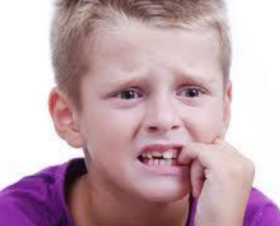
What are they feeling?
What zone are they in?
Notes:
Worried

Slide 16
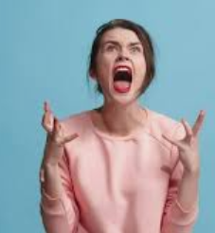
What are they feeling?
What zone are they in?
Notes:
Angry

Slide 17
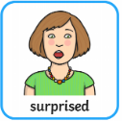
What are they feeling?
What zone are they in?
Notes:
Surprised

Slide 18
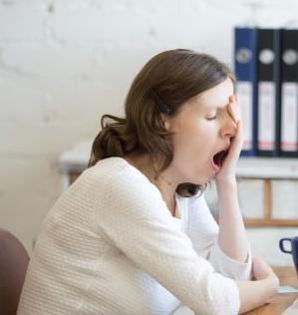
What are they feeling?
What zone are they in?
Notes:
Tired

Slide 19

What are they feeling?
What zone are they in?
Notes:
Excited

Slide 20
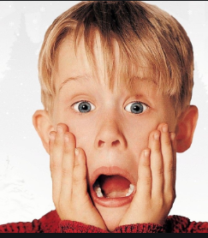
What are they feeling?
What zone are they in?
Notes:
Scared

Slide 21
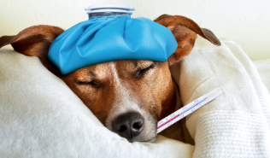
What are they feeling?
What zone are they in?
Notes:
Poorly

Slide 22
https://www.youtube.com/watch?v=tdxR-4Wf4Z8&list=PL2yWdO8V50Kgqf6vNvnc9sP92kW3wShul
https://www.youtube.com/watch?v=eWXOurnVTYg&list=PLf-eKCHmUmTgrBlwiNC-TDf1mecfHe7gn
https://www.youtube.com/watch?v=H4BNbHBcnDI&list=PLQrZz8F5ernylySyWqq5-dL3n0cKckUsB
https://www.youtube.com/watch?v=toYrL7Vyydc&list=PLbQ5eOCPVc1DeSEB1ft79Fxt4_KIOthjm
https://www.youtube.com/watch?v=2okrVHFKOoA&list=PLXXlw5bZYnCqtq03LaaeNuxAcHozkUfag
https://www.youtube.com/watch?v=RHpS7hlDqS0&list=PLJKNr8RaJKVY1svJMeDU-6GdyivjZdHfq
https://mcbehavior.weebly.com/zones-of-regulation.html
What zones are the characters in?
https://mcbehavior.weebly.com/zones-of-regulation.html
Various links
https://www.youtube.com/watch?v=a5ze5PfDEzI&list=PLf-eKCHmUmTg77BWb50jYROJ92Ytdeqax&index=2
https://www.youtube.com/watch?v=pN9V4LBCgSc&list=PLf-eKCHmUmTg77BWb50jYROJ92Ytdeqax&index=4
https://www.youtube.com/watch?v=et4oUMuBvoQ&list=PLf-eKCHmUmTg77BWb50jYROJ92Ytdeqax&index=5

Slide 23
The ZONEs of regulation
Session Two

Slide 24

Me in my zones
Notes:
Wecan recognise feelings in others, now we need tothink about ourselves.

Slide 25
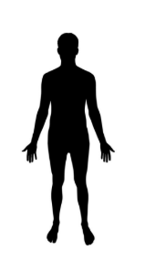

Our body’s responses change in different ZONEs of regulation

Slide 26
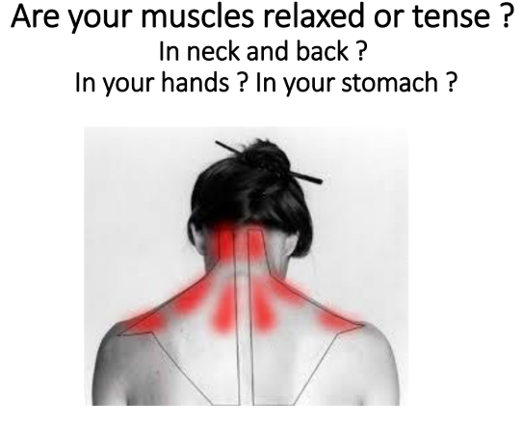
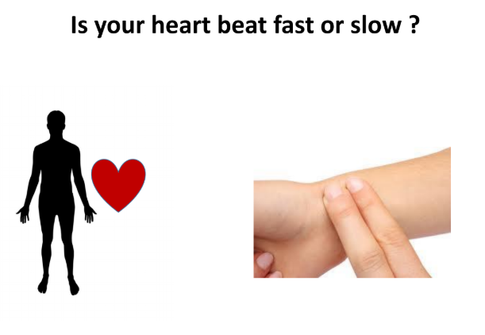
How our bodies feel

Slide 27
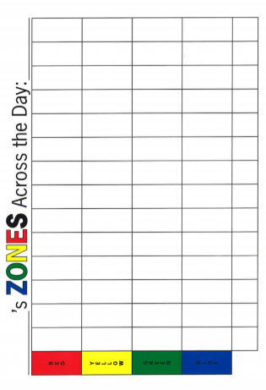
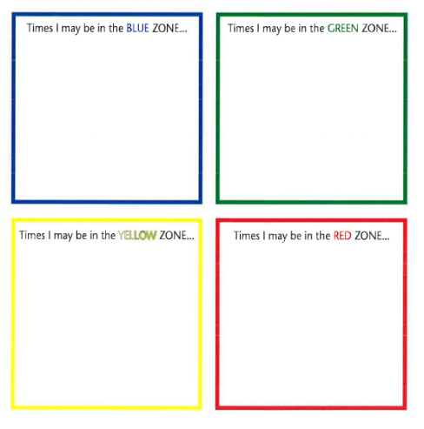
How do I feel across the day
Worksheet
Notes:
On sheet talk about the day and what zones we would be in at different times,
Adults (staff meeting)
Alarm going off, bath/shower, Breakfast, going outside to find an icy car. Getting stuck in traffic so being late for school, getting told you have extra time for PPA etc lunch time and someone has kindly put in some puddings, after school you meet a difficult parent, on way home you have to gothe supermarket, cooking dinner, eatring your favourite dinner, then you remember you have to do some ironing, Sit down to watch your favourite TV programme then go to bed.
Childrens version Alarm going off, downstaris for breakfast, Getting stuck in traffic being late for school, getting told off for not handing in your homework, then you have your worst subject, then having lunch but its wet play then having your best subject, getting picked up from school by mummy who has bought your favourite snack. Having to go to ht supermarket to get some food on the way home. Having to do your maths homework, mummy jhas cooked your favourite dinner. You are allowed to watch TV befoiree going up to bed. Bath time Bedtime story bewfore bed.

Slide 28

Weird smell
Making a mistake
Having to tidy up
Bring tired
Loud noise
Being told no
Waiting my turn

Slide 29
What triggers you?
Worksheet
What triggers you?

Slide 30
The ZONEs of regulation
Session Three

Slide 31
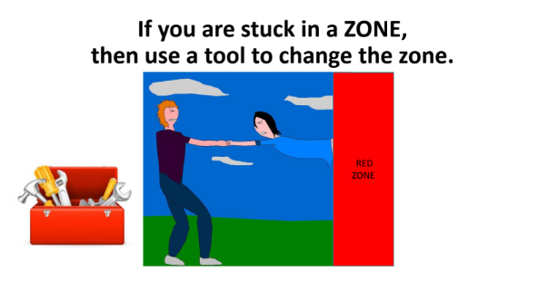
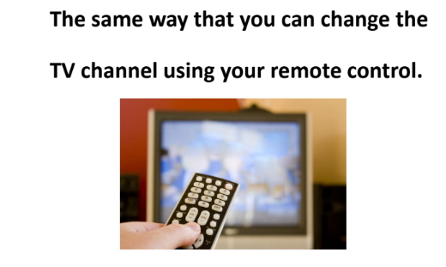
Notes:
You are the driver in control of your body engine. You can change your engine speed. To try to get it in the perfect mood for learning and getting things done.

Slide 32
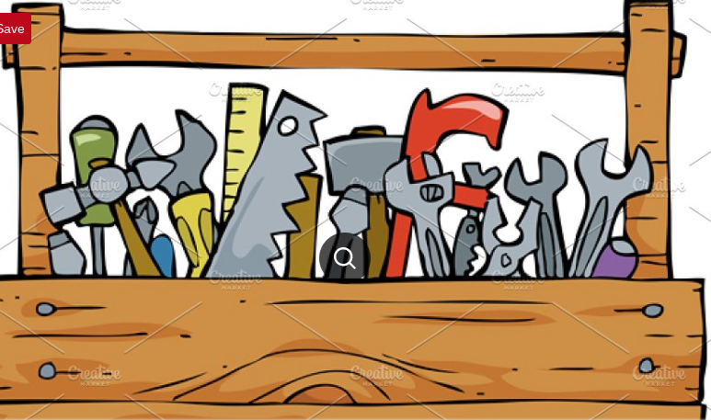
Tool box
Notes:
When we have unexpected bahiours it is a sign to us that weneed tomanage our behaviour and use a tool to help us. To help us to manage our behaviour
https://www.zonesofregulation.com/teaching-tools.html - assembly about the zones and using the tools.

Slide 33
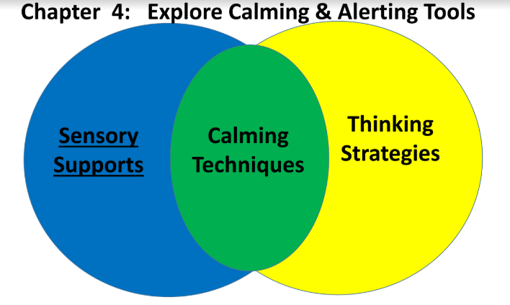

Slide 34
Drink from a straw
Drink water
Read a book
Wiggle cushion
Listen to music
Yoga poses
Stress ball
Putty
Sensory techniques

Slide 35
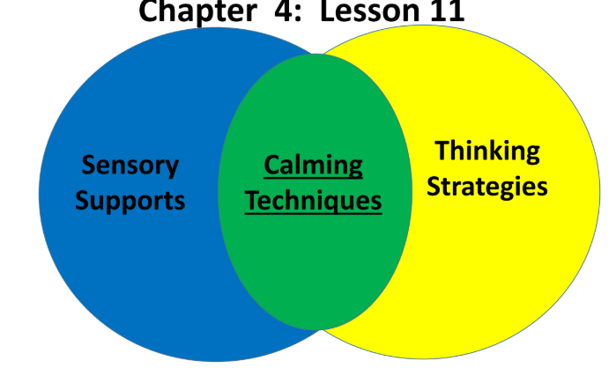

Slide 36
Deep breathing
Count to ten
Lazy 8 breathing
Take a break
Go for a walk mindfulness
Calming techniques

Slide 37
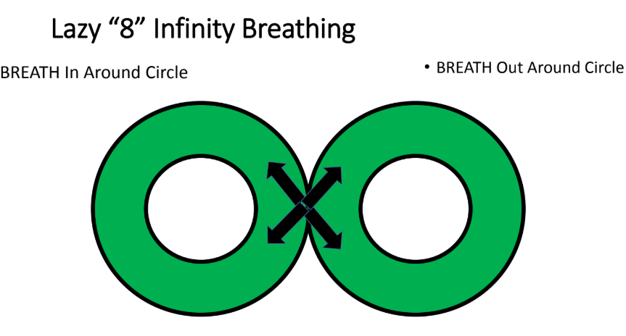
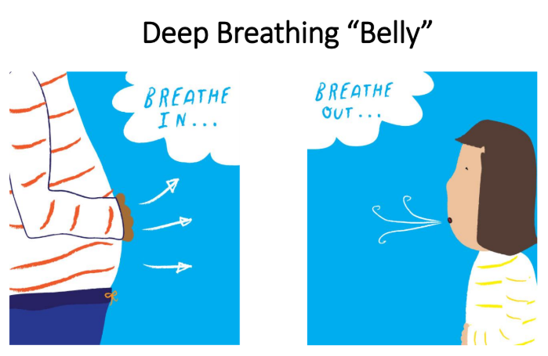
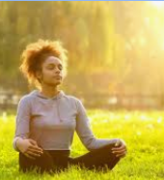
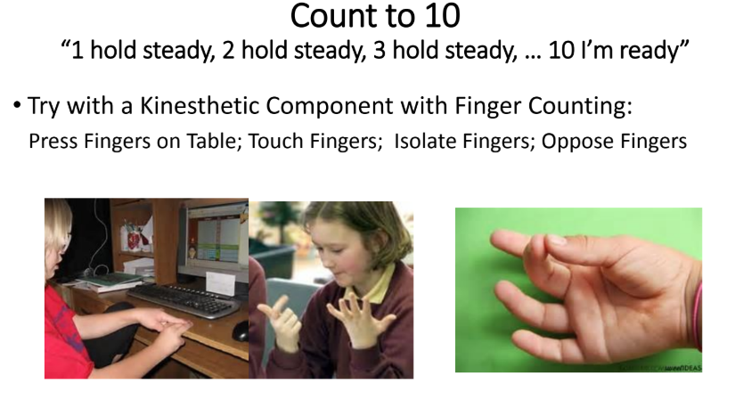
Notes:
Find things that work for you.

Slide 38
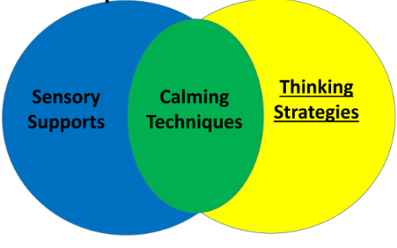

Slide 39
Thinking strategies
Think about the size of a problem
Inner coach
Reflective thinking
Problem solving
Growth mindset

Slide 40
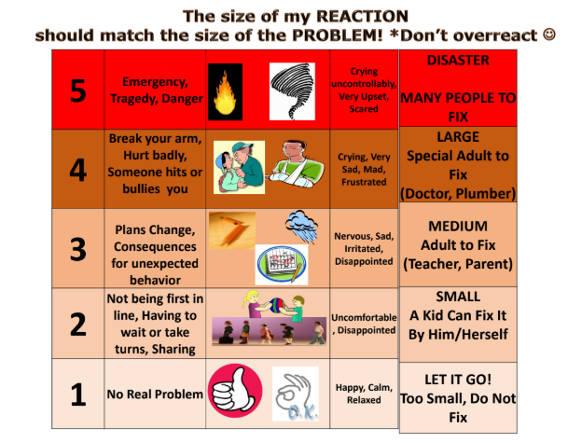
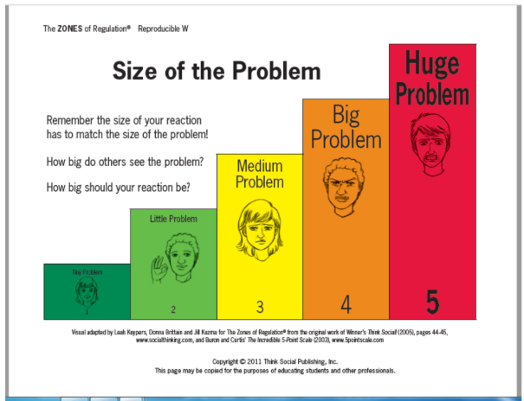
Notes:
We can think about where our problems would fit, on this chart.
Where would not having our PE kit go? Where would bringing the wrong pencil to school go? Where would having to go swimming go? Where would a friend borrowing your glue without asking go? Where would … go?

Slide 41
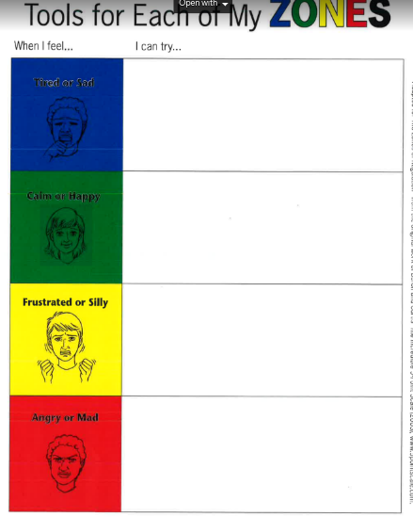
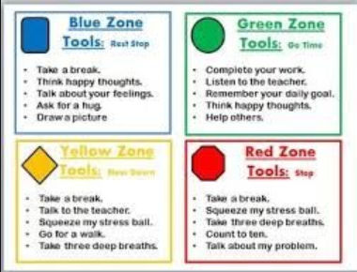
Tools for each of my zones
Worksheet
Listening to music
Stretch and stand
Having a glass of cold water
Breathing in and out
Count back from 10
Going for a walk in fresh air
Using a stress ball
Listen to music

